Slide 1
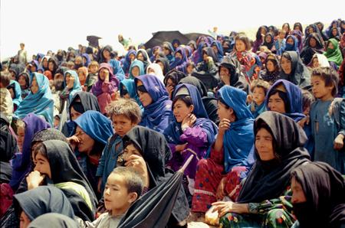
Hazara People
Hazaristan
Hazara Faces
Persecution of the Hazara people
Presented by Kamran Mir Hazar
Photos by: Muzafar Ali, Najibullah Musafer, Basir Seerat, Muhammad Raja and Mahdi Mudaber
The Hazara are a Turkic people, and descendants of the Kushans. Mongol influences are present in 10% of the Hazara. Hazara people live primarily in several Central Asian countries such as Afghanistan, Iran, Turkmenistan, Kazakhstan, Pakistan, and India. Millions of Hazara people throughout history have been forced to leave their original homeland-- today called Afghanistan. Hundreds of thousands of Hazara have settled as refugees and political asylees in Europe, the Americas, and Australia.

Slide 2
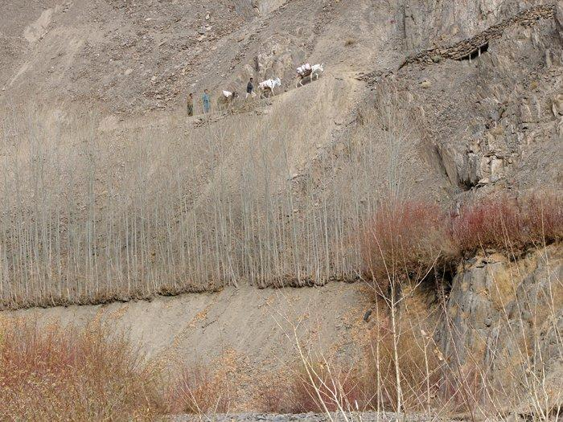
Hazaristan
A narrow and dangerous mountain path in the Khedir district of Dai Kundi Province. During winter rainy seasons these passages are very dangerous and many travelers lose their lives by falling into raging rivers.

Slide 3
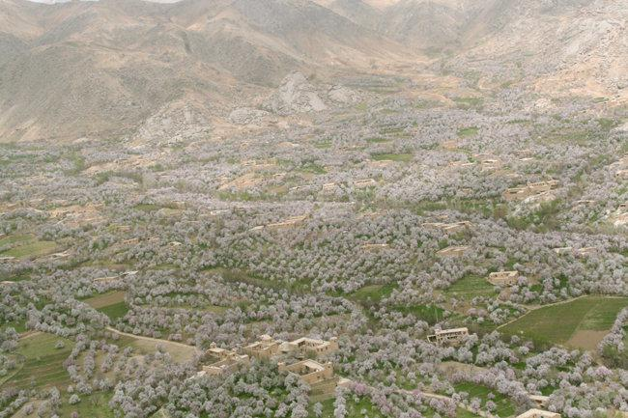
Hazaristan
During the winter season Daikundi's Nili is covered in snow, but in spring it is covered in white almond tree flowers. Just one day after Nawroz (New Year), almond trees bloom. This picture was taken on 22 March 2010. Dai Kundi is famous in Afghanistan for the best quality almonds.

Slide 4
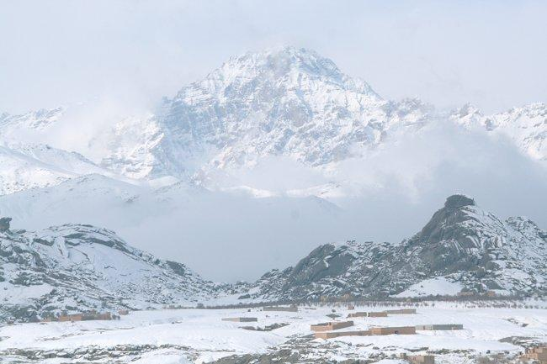
Hazaristan
Nili in winter (Dec. 2009)

Slide 5
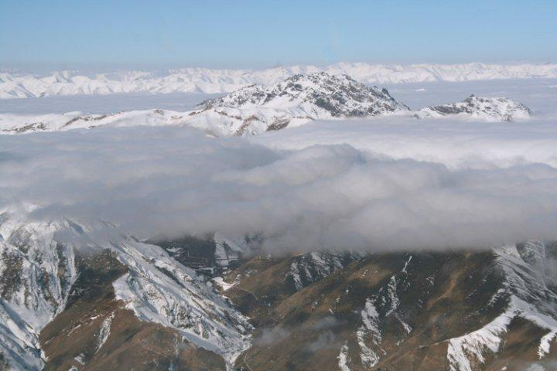
Hazaristan
A mountain above the clouds in the Waras District of Bamyan.

Slide 6
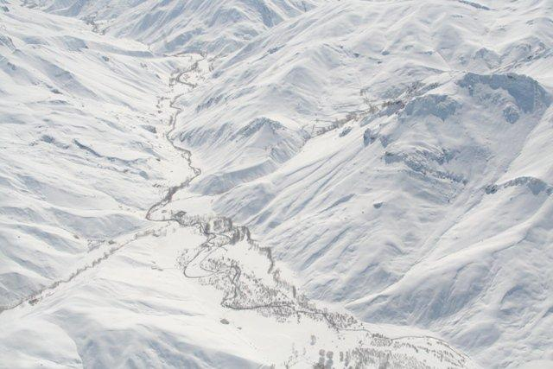
Hazaristan
A snowbound valley of the Waras district of Bamyan, shot on Feb. 8, 2010. Heavy snowfalls have caused many casualties in Bamyan and Dai Kundi.

Slide 7
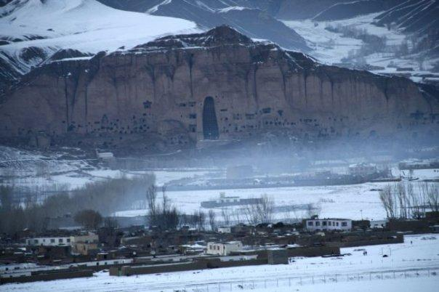
Hazaristan
Bamyan in winter.

Slide 8
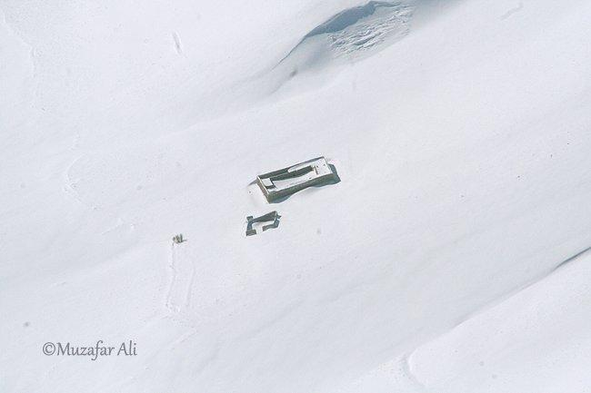
Hazaristan
A house in the Yakawlang District, Bamyan Province in winter. Hazaristan becomes one of the most isolated places in the world during winter.

Slide 9
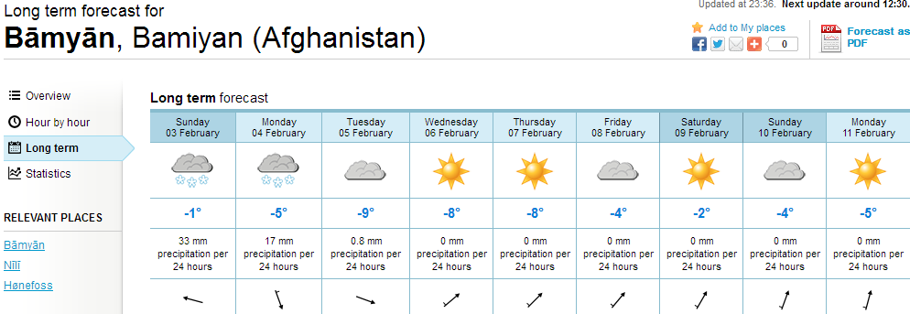
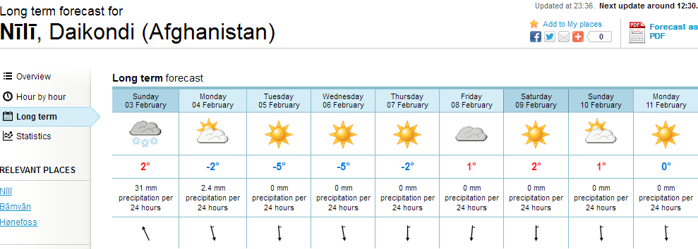
www.yr.no
Recently, the weather has been much better, when compared to previous Januarys when temperatures reached -20°.

Slide 10
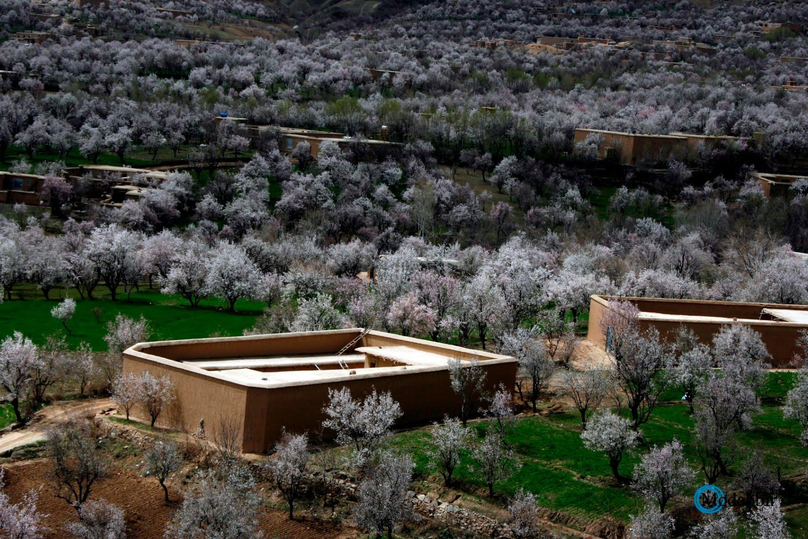
Hazara Faces
Almond flowers/ Daikondi Spring 2013

Slide 11
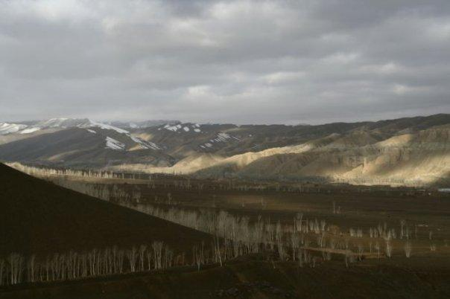
Hazaristan
Bamyan in autumn. Bamyan hosts several rare species of birds during their annual migration over the city. The Giant Crane is one of them.

Slide 12
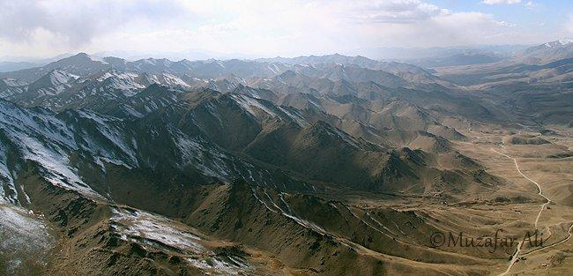
Hazaristan
Aerial view of Behsood 1 District, Maidan Province.

Slide 13
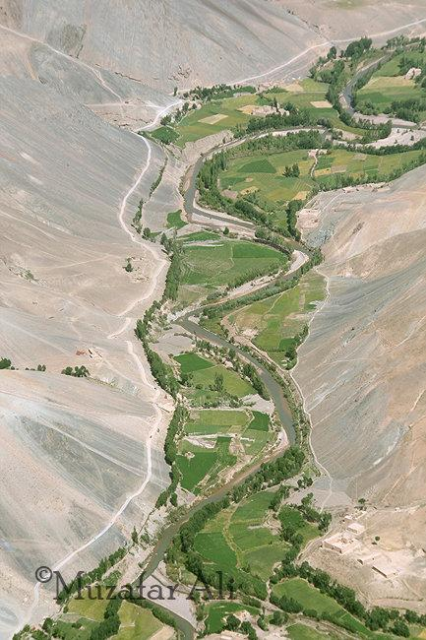
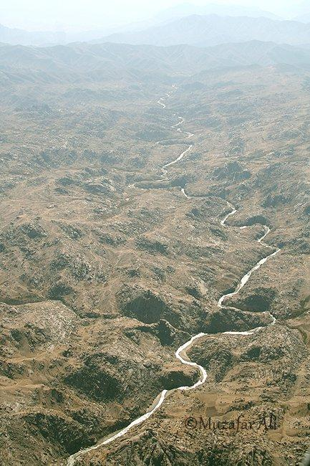
Hazaristan
Aerial view of a valley in Panjao District, Bamyan
Aerial view of the Lazir River, Nili, Daikundi.

Slide 14
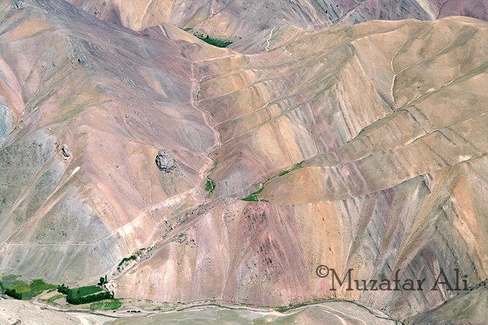
Hazaristan
Aerial view of a colorful mountain in the Panjao District, Bamyan.

Slide 15
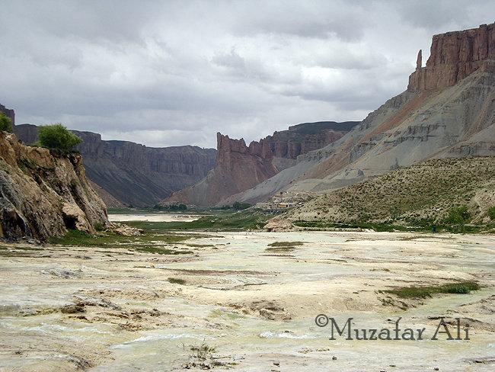
Hazaristan
Band-e-Amir, Bamyan on June 20, 2009.

Slide 16
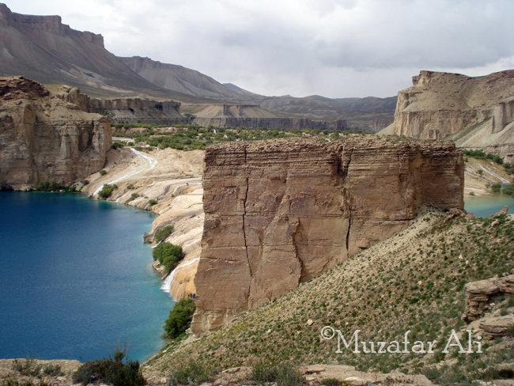
Hazaristan
Band-e-Amir, Bamyan on June 20, 2009.

Slide 17
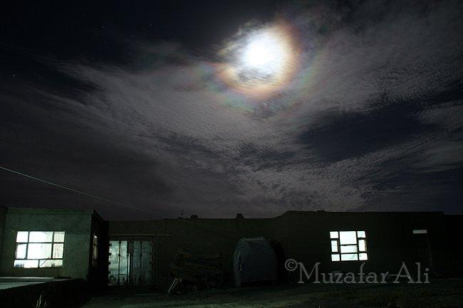
Hazaristan
A poetic night in Bamyan

Slide 18
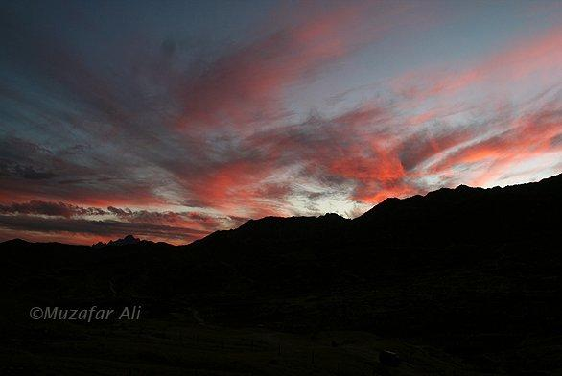
Hazaristan
Red clouds in Nili, Daikundi at dusk.

Slide 19
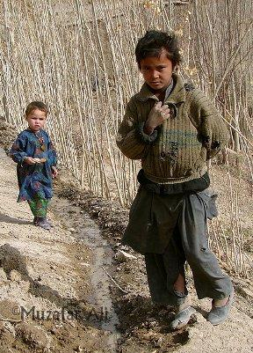
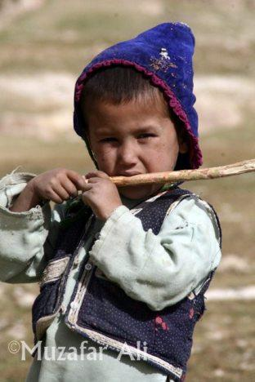
Hazara Faces
Boys from the Mirasi Valley, Sangtakht District, Daikundi Province.
A Hazara boy from the Khawat Village, Nawur District of Ghazni Province.

Slide 20
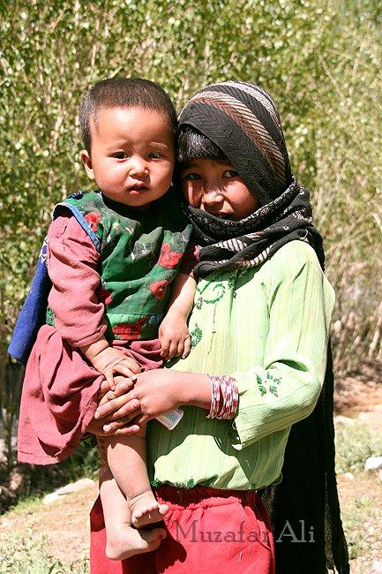
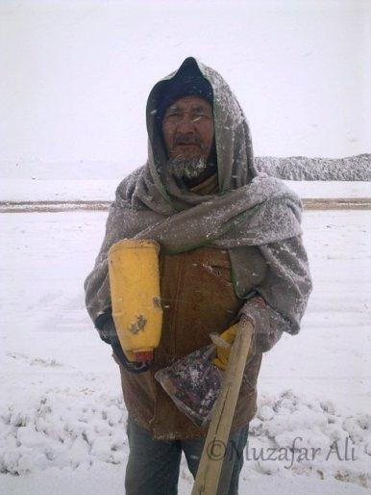
Hazara Faces
An old man with a gallon of water and bag of bread at work on the Nili Airstrip, Daikundi. The work continues despite the extreme weather.
A girl with her brother in Pul Band Shoy Village, Behsood 2 District, Maidan Province.

Slide 21
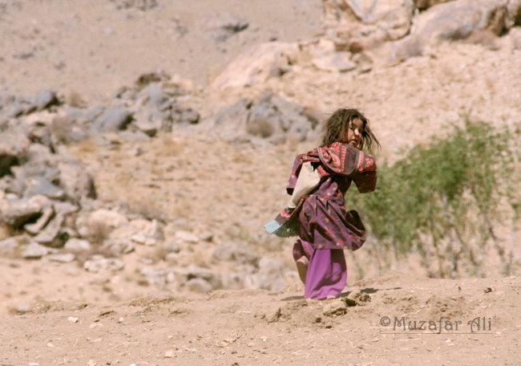
Hazara Faces
This young girl was too frightened to be photographed. She thought I might shoot her, and ran towards her house. (Shot in Nili, Daikundi)

Slide 22
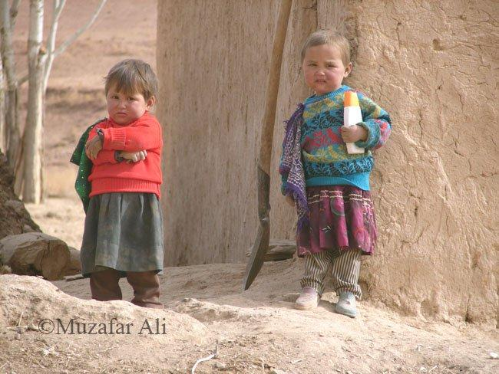
Hazara Faces
Children near Siah Chob Village, Sangtakht District, Daikundi. Look at the shoes of the girl on the right. Notice the different colours, and both shoes are for the LEFT foot!

Slide 23
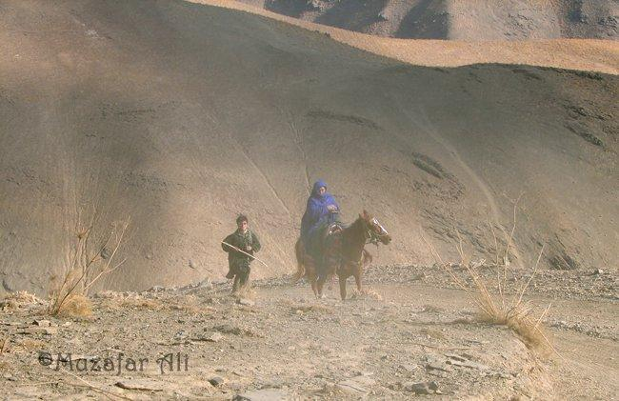
Hazara Faces
A woman on horseback crosses Shah Tigh Pass, Khedir District Daikudi.

Slide 24
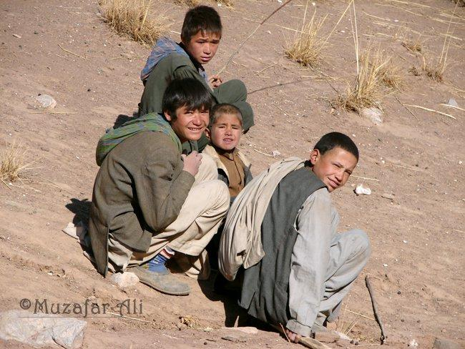
Hazara Faces
Some nervous faces from the Pusht Ruq Village, Khedir District, Daikundi Province. Though many parts of Daikundi Province have been affected by war, the Khedir District was one of the worst affected areas.

Slide 25
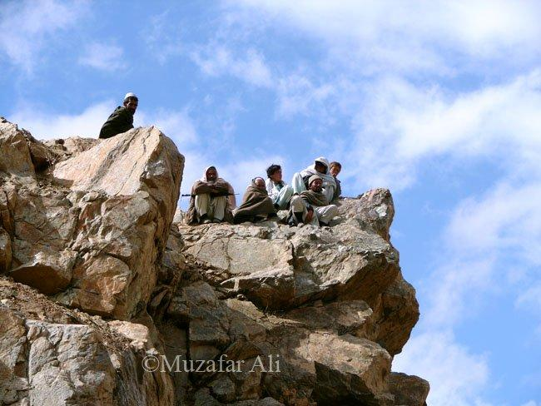
Hazara Faces
Men in Nili, Daikundi gazing at the raging Lazir River (2005)

Slide 26
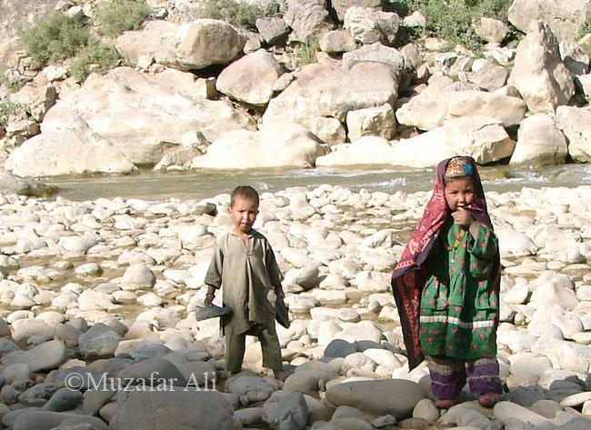
Hazara Faces
Two young Hazara children play on a rocky bank of the Lazir River.

Slide 27
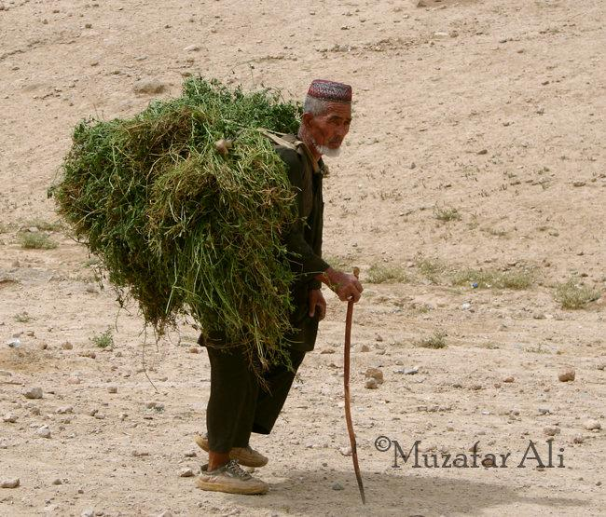
Hazara Faces
He needs a stick to support his back, but still must work to survive. From Ashtarlai District, Daikundi.

Slide 28
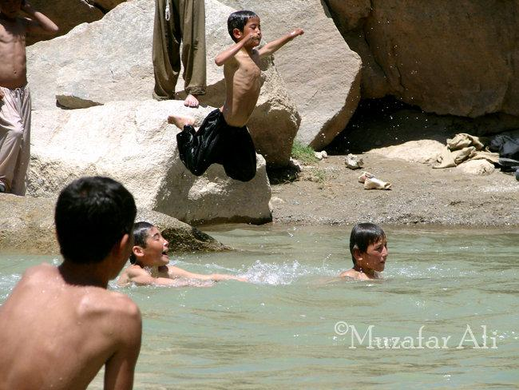
Hazara Faces
Boys enjoy swimming in the Lazir River, Nili, Daikundi

Slide 29
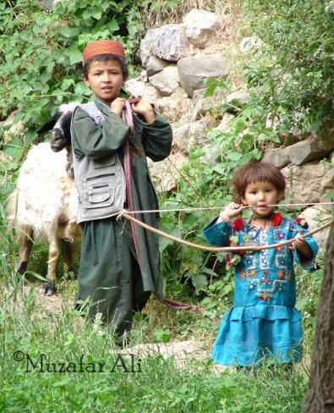
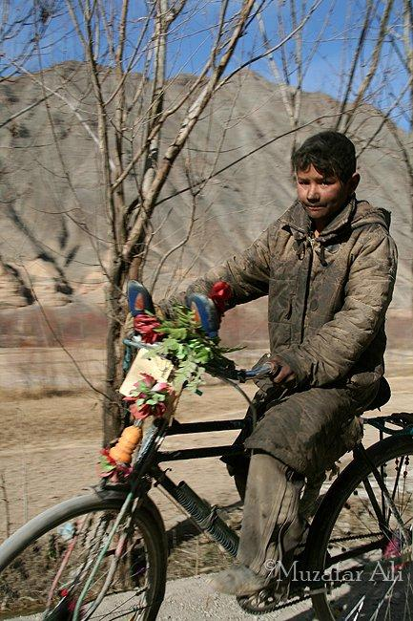
Hazara Faces
The bow is still a popular toy with children from the Upper Kissow Valley. Instead of arrows they shoot pebbles. The Upper Kissow Valley is like heaven, and accordingly the people are loving and open.
A young coal miner from the Du Aab Mekh Zarin Village, Kahmard District, Bamyan Province.

Slide 30
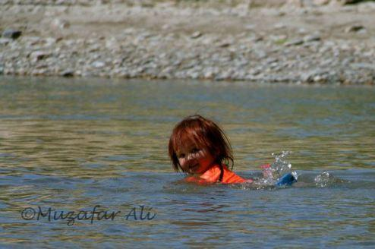
Hazara Faces
A cute girl, Fatima from Shah Neko Village, Nili Center, Daikundi Province swims in the Lazir River.

Slide 31
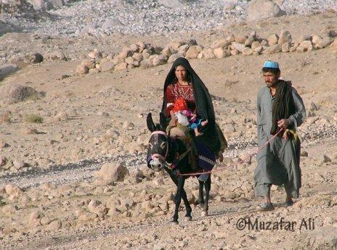
Hazara Faces
A Hazara family heads to a clinic in the Kissow Valley, Kitti District, Daikundi Province.

Slide 32
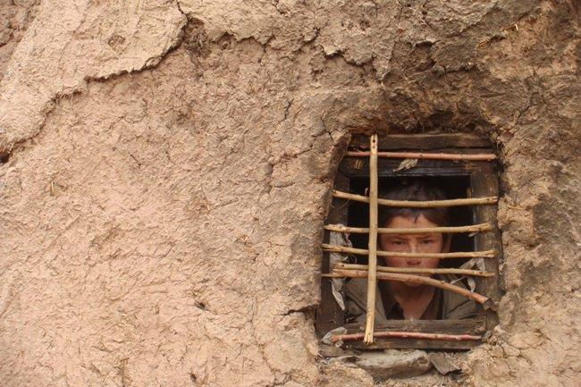
Hazara Faces
A boy looks from a window in his house in Bamyan Center, Bamyan.
Photo taken by Hameed Driver, Bamyan.

Slide 33
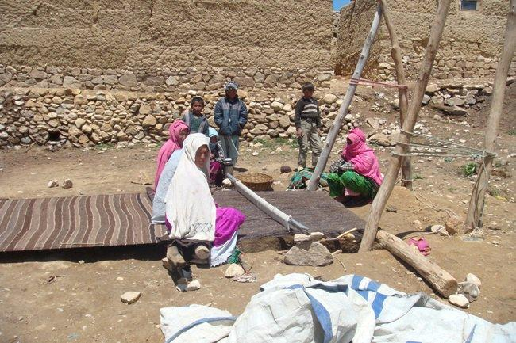
Hazara Faces
Women in Hazaristan gather to weave carpet in autumn when they have less work in the fields. During spring and summer, they help men harvest and prepare for winter. Photo by Hameed Driver, Bamyan.

Slide 34
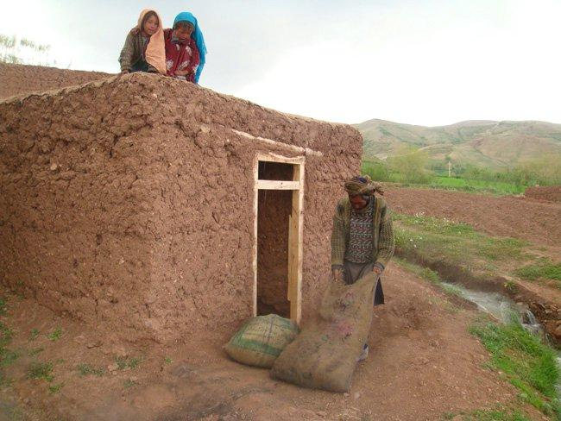
Hazara Faces
Preparing for the long and harsh winter season in Bamyan. Photo by Hameed Driver, Bamyan.

Slide 35
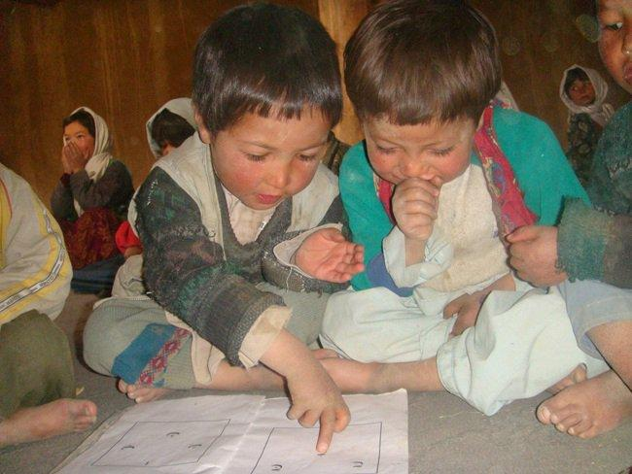
Hazara Faces
Excitement beams in the faces of young Hazara students in Bamyan-- both boys and girls. In most of Afghanistan, the government struggles to support education, because of the Taliban's constant threat. Education flourishes in Hazara areas, but the government does little for education in these remote and isolated areas. Instead it focuses on places where people don't value modern education, especially the education of girls. Photo by Hameed Driver, Bamyan

Slide 36
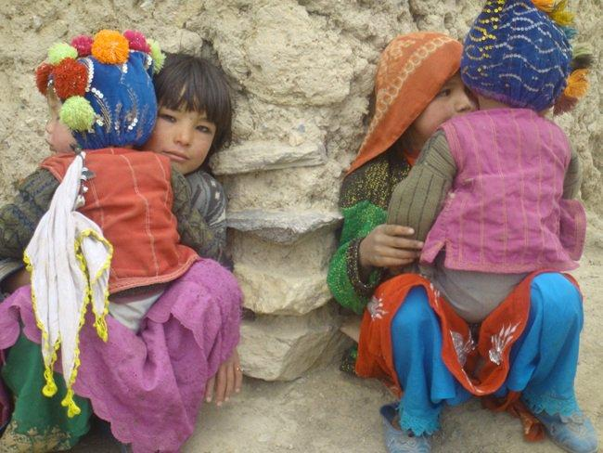
Hazara Faces
Girls carry their brothers in Bamyan Center, Bamyan. Photo by Hameed Driver, from Bamyan.

Slide 37
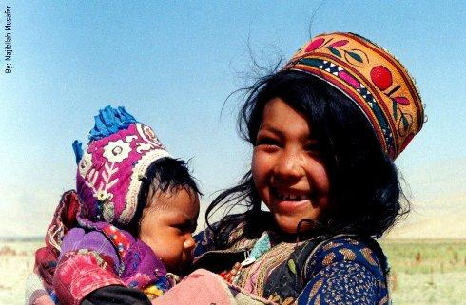
Hazara Faces
Chardeh village, Darasouf district, Samangan province.

Slide 38
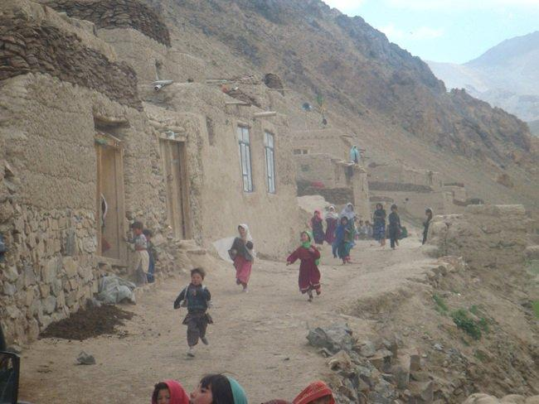
Hazara Faces
Colorfully dressed girls and women are a contrast to the stark Bamyan village landscape. Photo by Hameed Driver, Bamyan.

Slide 39
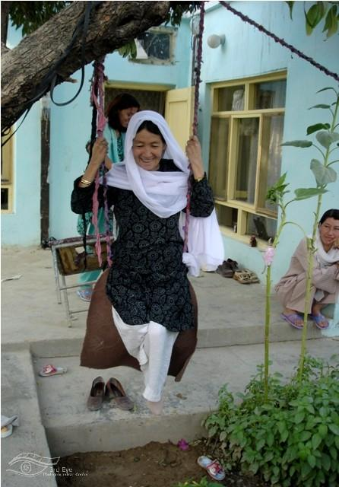
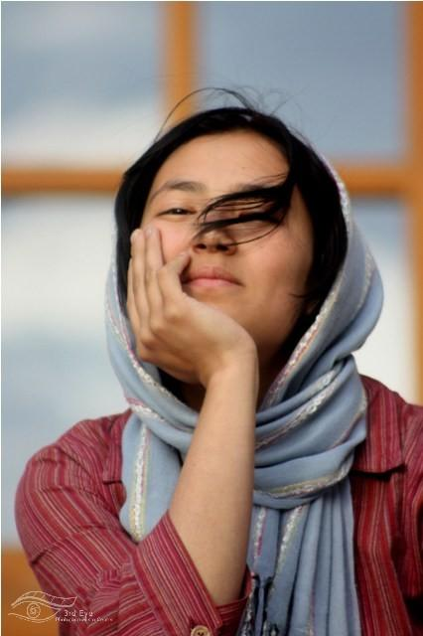
Hazara Faces
Photos by By Basir Seerat

Slide 40
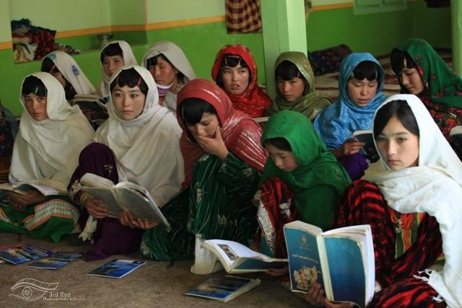
Hazara Faces
The Hazara insist on educating girls. Photo by By Basir Seerat

Slide 41
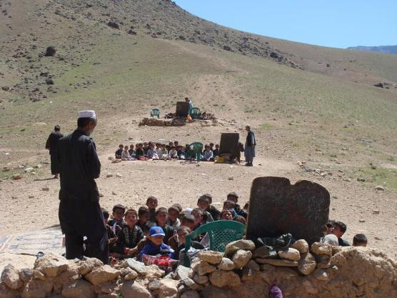
Hazara Faces
A school in Daikondi. Photo by Muhammad Raja

Slide 42
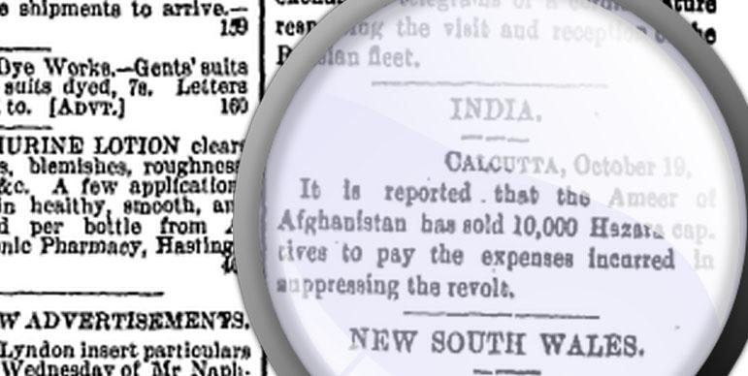
Persecution of the Hazara people
Hawke's Bay Herald, Volume XXVIII, Issue 9508, 20 October 1893, Page 2 INDIA. "CALCUTTA, October 19. It is reported that the Ameer of Afghanistan has sold 10,000 Hazara captives to pay the expenses Incurred in suppressing the revolt."

Slide 43
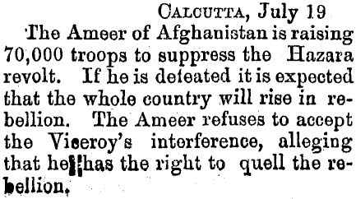
Persecution of the Hazara people
Thames Star, Volume XXIII, Issue 7241, 20 July 1892, Page 2

Slide 44
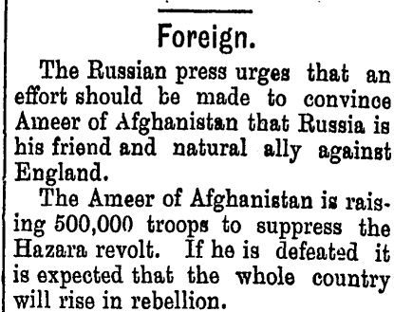
Persecution of the Hazara people
Manawatu Herald , 23 July 1892, Page 2

Slide 45

Persecution of the Hazara people
THE AMIR OF AFGHANISTAN CONDEMNING TO DEATH HAZARA PRISONERS OF WAR .
The Graphic (London, England), Saturday, November 4, 1893

Slide 46

Persecution of the Hazara people
Hazara
Land
1
8
9
2
Hawke's Bay Herald, Volume XXVII, Issue 9128, 11 August 1892, Page 3
Pashtun Kuchi attacks from 19th to 21th century

Slide 47

Persecution of the Hazara people
Kuchi-Pashtun attack Hazaras, looting, burning Hazara homes and claiming Hazara land based on Pashtun Ameer's Farman.
2
0
0
7
Pashtun Kuchi attacks from 19th to 21th century

Slide 48

Persecution of the Hazara people
Hazara homes in Behsood looted; Afghan Army stands by chatting with looters
Kabulpress.org was notified today of this video on YouTube. Taped by Mr. Mohammad Ahmadi in the Hazara area of Behshood, Afghanistan, the video shows a pick-up truck piled high with goods looted from the Hazara homes in the background.
Note that the goods include rugs, appliances, and large sacks of grain— all valuable items that can be re-sold. Clothing and other items have been strewn in the dirt. The goal is to discourage Hazara, who fled attacks that have led to many dead and wounded, from returning to their homes.
The Hazara people have lived in Behsood for at least 3,000 years, but their Asian roots and beliefs, stemming more from Buddhism than Islam have made them continual targets of Pashtuns. Hazara culture promotes democracy, equal justice, women's rights and education for all. This has been a great problem with Taliban supporters and fundamentalist Muslims, who are intent on dispersing millions of Hazara, and weakening their influence in modern Afghanistan
Bloody attacks against Hazaras in Afghanistan force thousands to flee Use ctrl + click to open link.
Pashtun Kuchi attacks from 19th to 21th century

Slide 49

Persecution of the Hazara people
Pashtun Kuchi attacks from 19th to 21th century
Back to the primitive past: Pashtuns stoning, trampling with horses, and burning their victims with impunity Use ctrl + click to open link.

Slide 50

Persecution of the Hazara people
Pashtun Kuchi attacks from 19th to 21th century
Use ctrl + click to open link.
Report on the Case of Conflict between Kochies and the local people in Behsood. Afghanistan Independent Human Rights Commission (AIHRC)

Slide 51

Persecution of the Hazara people
Afghanistan’s entire 20th century history has been marked by killings of Hazaras and systematic discrimination against them.
Abdul Khaliq Hazara was a teenage Hazara student who was studying in Kabul. On November 8, 1933 he assassinated Dictator Nadir Khan during a high school visit. He and his entire family and friends were executed publicly. After Dictator Nadir's death, his son, the new king, and his brothers tried to establish relations with the Nazis, based on their common "Aryan race."

Slide 52

Persecution of the Hazara people
Mullah Omar Farman Plans to Destroy the Hazara Cultural and Historical Monument of the Buddahs of Bamiyan
ISLAMIC AMARAT OF AFGHANISTAN MOVEMENT OF TALIBAN
QANDAHAR PROVINCE (SECRET SERVICE CELL).
SECRET ORDER.
1.Ruthless army steps by Taliban against opponent enemy groups.
2.Recovery of arms and collection of Islamic Taxes.
3.Demolition of Mughul,s (Hazaras) historic cultural heritage and remains.
4.Ban for celebrating of Jashn-e-Nouroz (a cultural festival/ new year)
5.Complete economic embargo of Hazarajat.
6.Strict army measures to disown Hazara tribes from their lands and properties forcibly.
7.Disintegration of Hazarajat gradually.
8.Elimination and arrest of communist elements.
9.Rooting out of all mysterious and opponent forces.
10.Anti Shiite propaganda campaign.
11.Assistance for Islamic Madrasas (religious schools) and religious groups.
12.Strict control and watch on women ( to out of their homes).
13.Complete recovery of Taxis from Opium production.
14.Care for transportations and oil.
15.Assistance of Akhund Zadas (Taliban) and religious Mullas.
16.Assistance and care for pro-Taliban Shiite Mullas and commander.
Attention for Kajiki, Kishki Nakhud, Kalat, Shah Joi, Maruf, Hlmand (Name of Provinces and Districts).
May be informed very quick.
Translation of the Pashto text (courtesy: Ishaq Mohammadi)

Slide 53


Persecution of the Hazara people
10–11 February
1993
Afshar, Kabul after the Massacre of Hazaras
More than five thousand Hazaras were killed by the Mujahideen government and its allies. Hazara homes were looted then destroyed in a hail of rockets.

Slide 54


Persecution of the Hazara people
Massacre of Hazaras in Afshar, Kabul

Slide 55

Persecution of the Hazara people
This report documents two massacres committed by Taliban forces in the central highlands of Afghanistan, in January 2001and May 2000. In both cases the victims were primarily Hazaras, a Shia Muslim ethnic group that has been the target of previous massacres and other serious human rights violations by Taliban forces. These massacres took place in the context of the six-year war between the Taliban and parties now grouped in the United National Islamic Front for the Salvation of Afghanistan (the 'United Front'), in which international human rights and humanitarian law have been repeatedly violated by the warring factions. Ethnic and religious minorities, and the Hazaras in particular, have been especially vulnerable in areas of conflict, and Taliban forces have committed large-scale abuses against Hazara civilians with impunity. In this report Human Rights Watch calls upon the United Nations to investigate both massacres and to systematically monitor human rights and humanitarian law violations by all parties to Afghanistan's civil war.
Human Rights Watch, Afghanistan: Massacres of Hazaras in Afghanistan , 1 February 2001, C1301, available at: http://www.unhcr.org/refworld/docid/3ae6a87c4.html [accessed 2 February 2013] Use ctrl + click to open link.
Afghanistan: Massacres of Hazaras in Afghanistan
Human Rights Watch

Slide 56


Persecution of the Hazara people
Ancient Buddha sculptures of Bamiyan, principal symbols of Hazara history and culture!
Destroying Hazara history and making and promoting an inaccurate, demeaning history of their culture have been further strategies, in addition to violent attacks. In March 2001, the Taliban notoriously destroyed the ancient Buddah sculptures of Bamiyan which were principal symbols of Hazara history and culture, and one of the most popular masterpieces of the oral and intangible heritage of humanity. Such is the history of two centuries of crimes against the Hazara, and from which they still suffer.

Slide 57

Persecution of the Hazara people
2007
Daikundi Province, where half-a-million people are dependent on agriculture, the Afghan Department of Agriculture in 2007 had a budget of only $2,400 to improve farming in the area.
Use ctrl + click to open link.
2007
Government's plan to build a modern prison in Daikundi;
Cost $795,566. Use ctrl + click to open link.
Less than 2% of National budget for Hazara- populated areas like Bamyan and Daikundi.

Slide 58

Persecution of the Hazara people
2
0
1
2
Hazara roads are blocked by Taliban gunmen. Hazara cars are halted and its passengers are killed.
A statement of Afghanistan Independent Human Rights Commission (AIHRC) in Dari Use ctrl + click to open link.

Slide 59

Persecution of the Hazara people
Genocide in Pakistan
Click here to see the map.
Pakistan: Abuses, Impunity Erode Rights
ATTACKS ON RELIGIOUS MINORITIES SURGE, JUDICIARY TAKES POLITICAL DECISIONS
Human Rights Watch

Slide 60

Hazara World-wide Protest
In the present Convention, genocide means any of the following acts committed with intent to destroy, in whole or in part, a national, ethnical, racial or religious group, such as:
(a) Killing members of the group;
(b) Causing serious bodily or mental harm to members of the group;
(c) Deliberately inflicting on the group conditions of life calculated to bring about its physical destruction in whole or in part;
(d) Imposing measures intended to prevent births within the group;
(e) Forcibly transferring children of the group to another group.
What is the Convention on the Prevention and Punishment of the Crime of Genocide for?
Kabul, Feb 2013
What is the Refugee Convention for?

Slide 61
Resources
Hazara People International Network
www.HazaraRights.com
Hazara Women International
www.HazaraWomen.com
Hazara People Rights
www.HazaraRights.com

