Slide 1
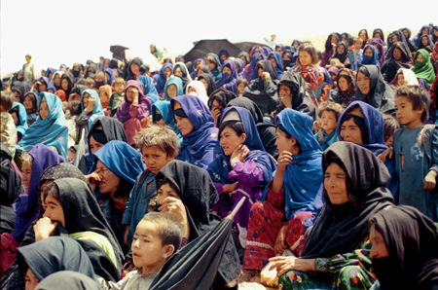
Hazara and Hazaristan
Hazaristan
Hazara Face
Persecution of the Hazara people
Presented by Kamran Mir Hazar
Photos by: Muzafar Ali, Najibullah Musafer, Basir Seerat, Muhammad Raja and Mahdi Mudaber
The Hazara are the native inhabitant of their homeland Hazaristan. They have rooted in their land for thousands of years and played vital roles in creating and maintaining civilization. “Starting from the 19th century, the Hazara of Hazaristan faced continuous, systematic crimes, including genocide, slavery, ethnic cleansing, and forced displacement. They were once the largest ethnic group in their country. Their territory, Hazaristan, was expanded from the very south to the north and from the east to the west (Bellew, 1880, pp. 113-117; Minority Rights, 2015). While the systematic crimes against the Hazara continued in the 19th century, and tens of thousands of Pashtun tribesmen (Thames Star, 1892; Waikato Times, 1892) backed and armed by the British colonial officers were attacking and invading the Hazara Dai-s from Kandahar in the south of Hazaristan (Poets World-wide, 2017; Temirkhanov, 1980, pp. 259-260), the name Afghanistan appeared on the maps (Vivien de St Martin, 1825). In the last decade of the 19th century, over fifty percent of the Hazara population, including almost all Hazara leaders and their families, massacred (Poets World-wide, 2017, p. 257; Temirkhanov, 1980)”.

Slide 2
Hazaristan

Slide 3
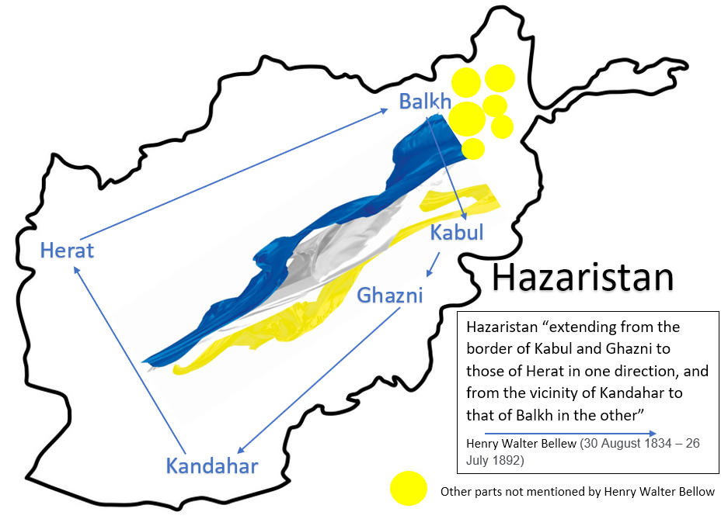
Hazaristan

Slide 4
Hazaristan
The Hazara were once the largest ethnic group constituting nearly 67 per cent of the total population of the state before the 19th century.
Minority Rights Group International

Slide 5
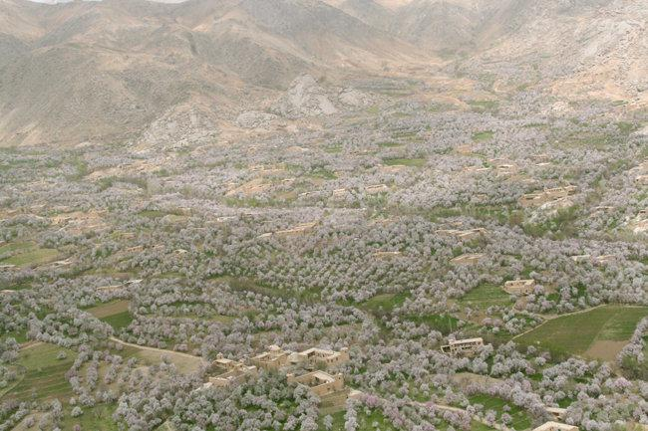
Hazaristan
During the winter season Daikundi's Nili is covered in snow, but in spring it is covered in white almond tree flowers. Just one day after Nawroz (New Year), almond trees bloom. This picture was taken on 22 March 2010. Daykundi is famous for the best quality almonds.

Slide 6
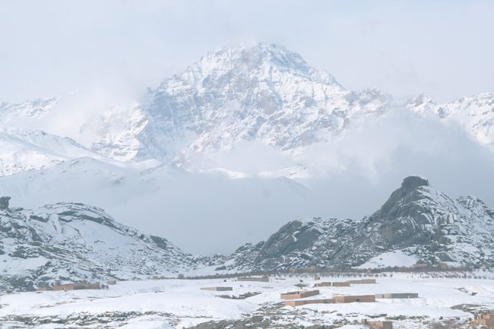
Hazaristan
Nili in winter (Dec. 2009)

Slide 7
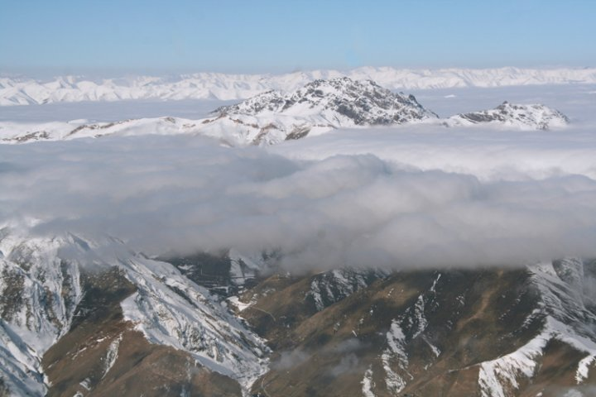
Hazaristan
A mountain above the clouds in the Waras District of Bamyan.

Slide 8
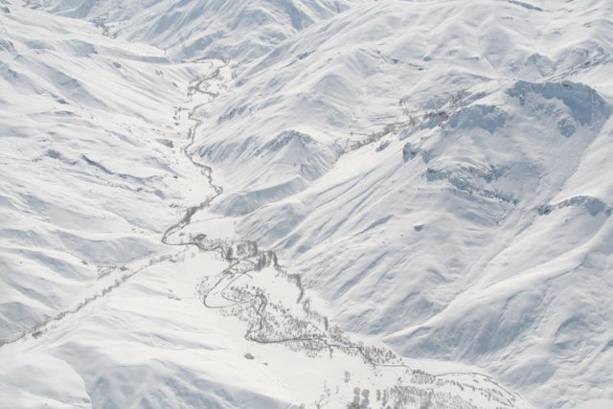
Hazaristan
A snowbound valley of the Waras district of Bamyan, shot on Feb. 8, 2010. Heavy snowfalls have caused many casualties in Bamyan and Daykundi.

Slide 9
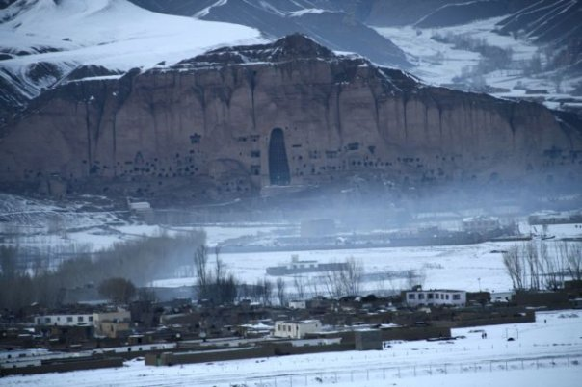
Hazaristan
Bamyan in winter.

Slide 10
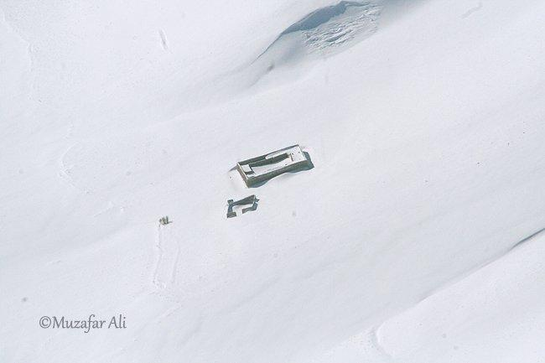
Hazaristan
A house in the Yakawlang District, Bamyan Province in winter. Hazaristan becomes one of the most isolated places in the world during winter.

Slide 11
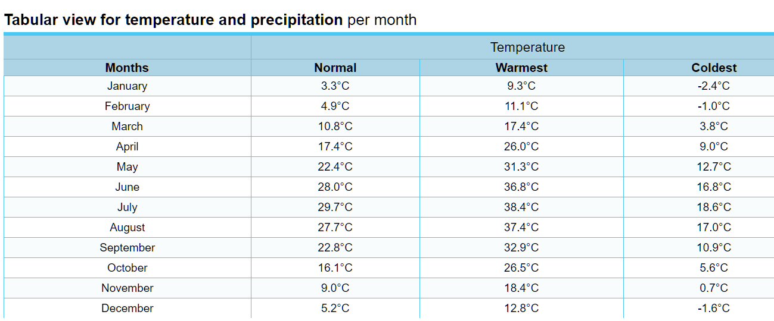
Hazaristan
www.yr.no
Nili, Hazaristan
Temperature and precipitation per month
yr.no

Slide 12
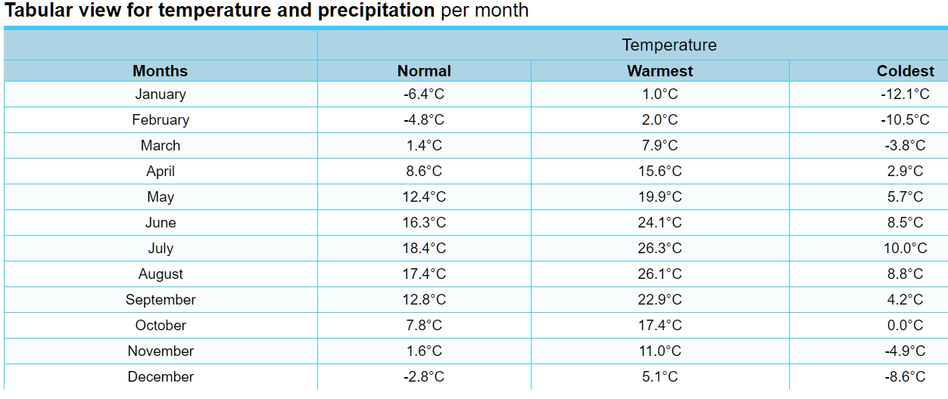
Hazaristan
www.yr.no
Bamyan, Hazaristan
Temperature and precipitation per month
yr.no

Slide 13
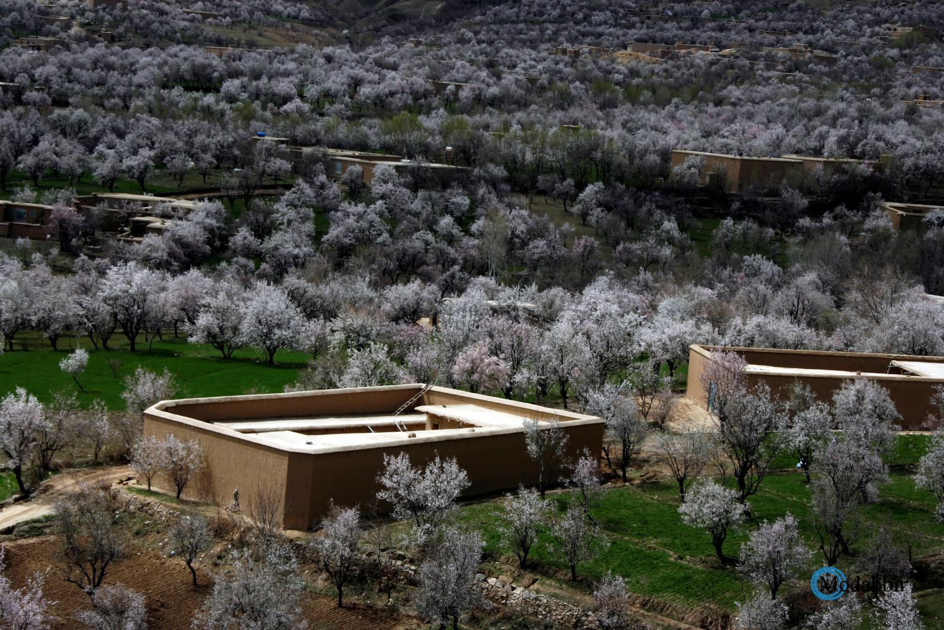
Hazaristan
Almond flowers/ Daykundi Spring 2013

Slide 14
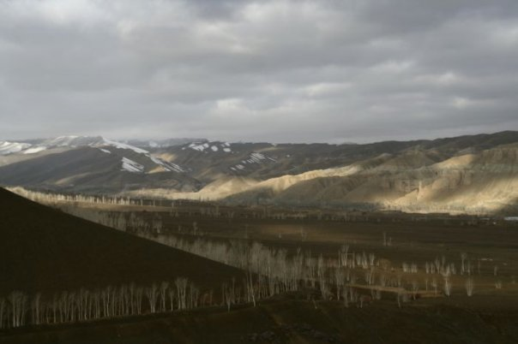
Hazaristan
Bamyan in autumn. Bamyan hosts several rare species of birds during their annual migration over the city. The Giant Crane is one of them.

Slide 15
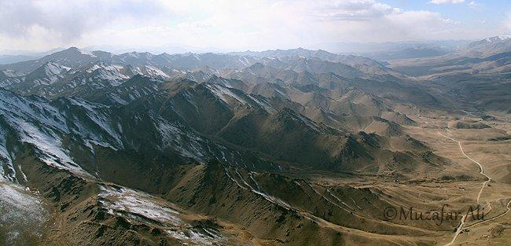
Hazaristan
Aerial view of Behsood 1 District, Maidan Province.

Slide 16
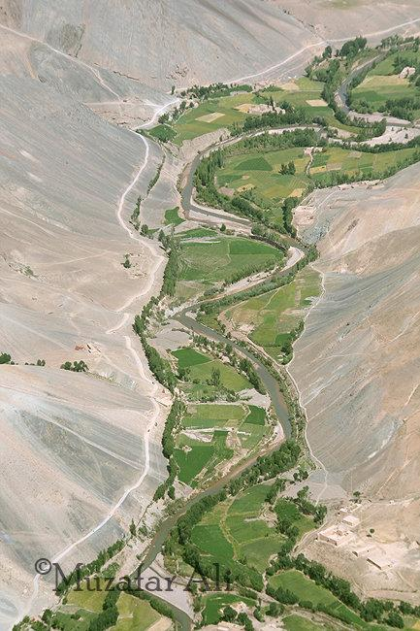
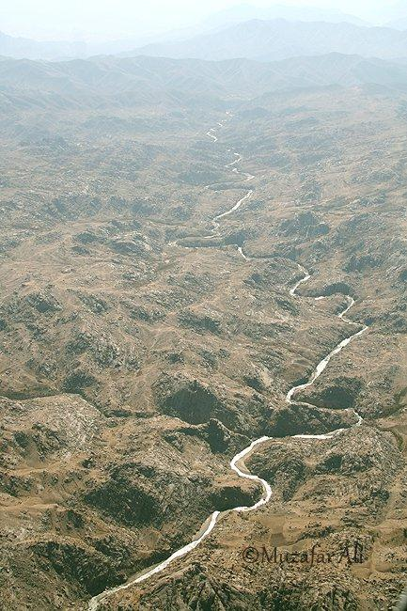
Hazaristan
Aerial view of a valley in Panjao District, Bamyan
Aerial view of the Lazir River, Nili, Daikundi.

Slide 17
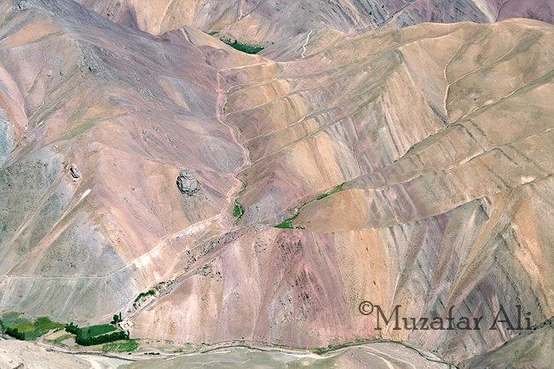
Hazaristan
Aerial view of a colorful mountain in the Panjao District, Bamyan.

Slide 18
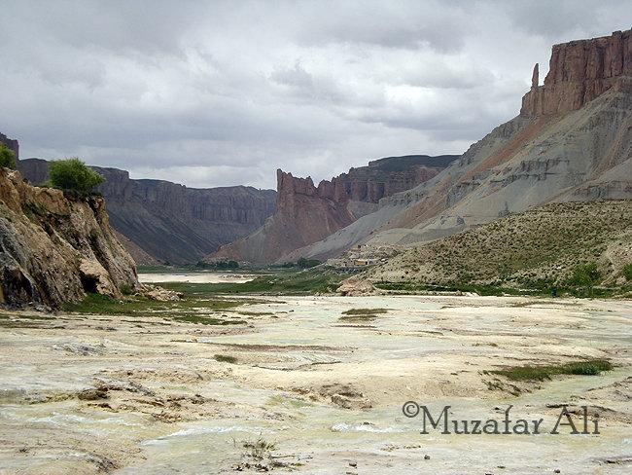
Hazaristan
Band-e-Amir, Bamyan on June 20, 2009.

Slide 19
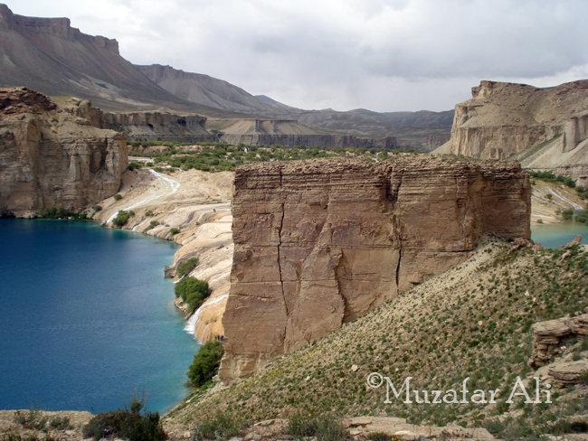
Hazaristan
Band-e-Amir, Bamyan on June 20, 2009.

Slide 20
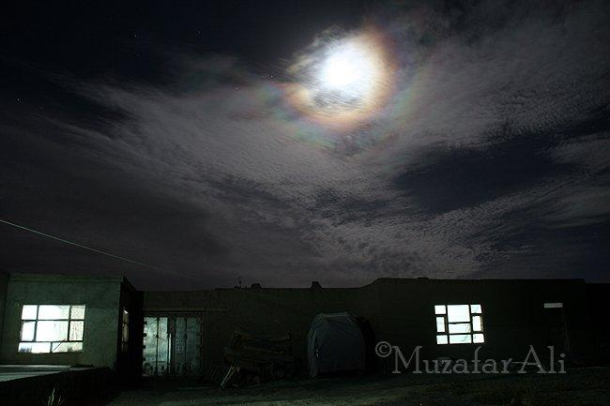
Hazaristan
A poetic night in Bamyan

Slide 21
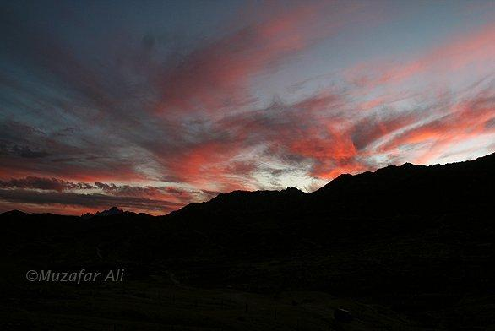
Hazaristan
Red clouds in Nili, Daikundi at dusk.

Slide 22
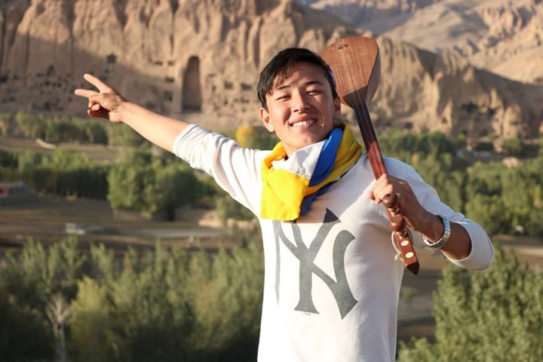
Hazara Face
A young Hazara with Hazaristan flag and Dambora the national instrument of Hazara in Bamyan, Hazaristan

Slide 23
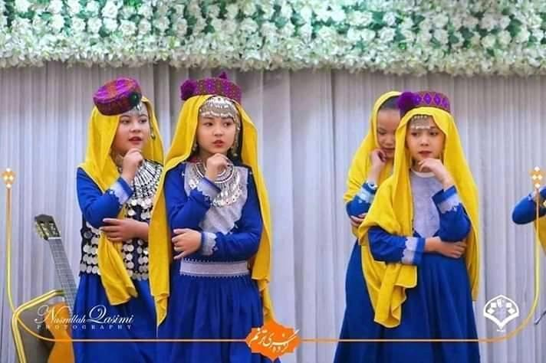
Hazara Face
Hazara costume and the flag of Hazaristan, another dimension of the color combination in Hazara national flag

Slide 24
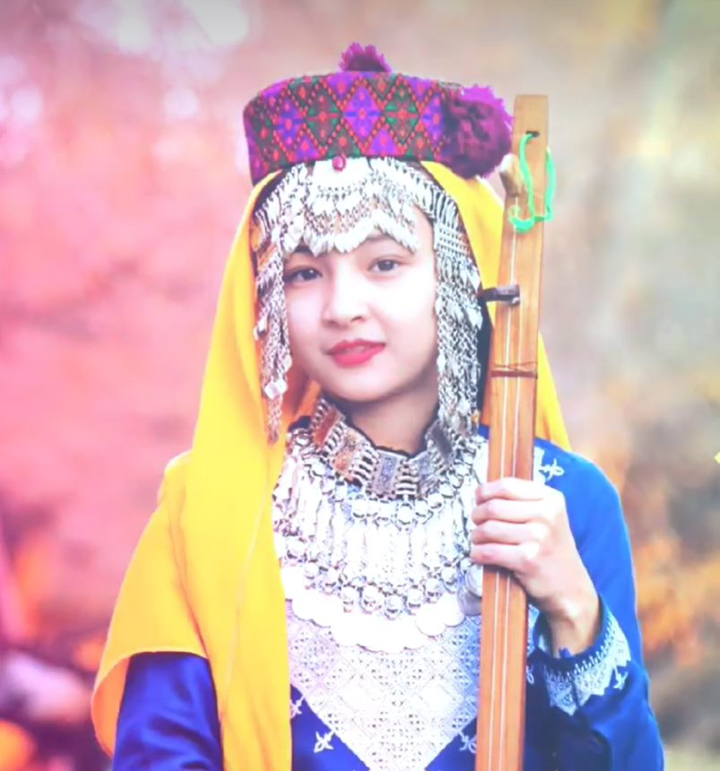
Hazara Face
Hazara costume and the flag of Hazaristan, another dimension of the color combination in Hazara national flag

Slide 25
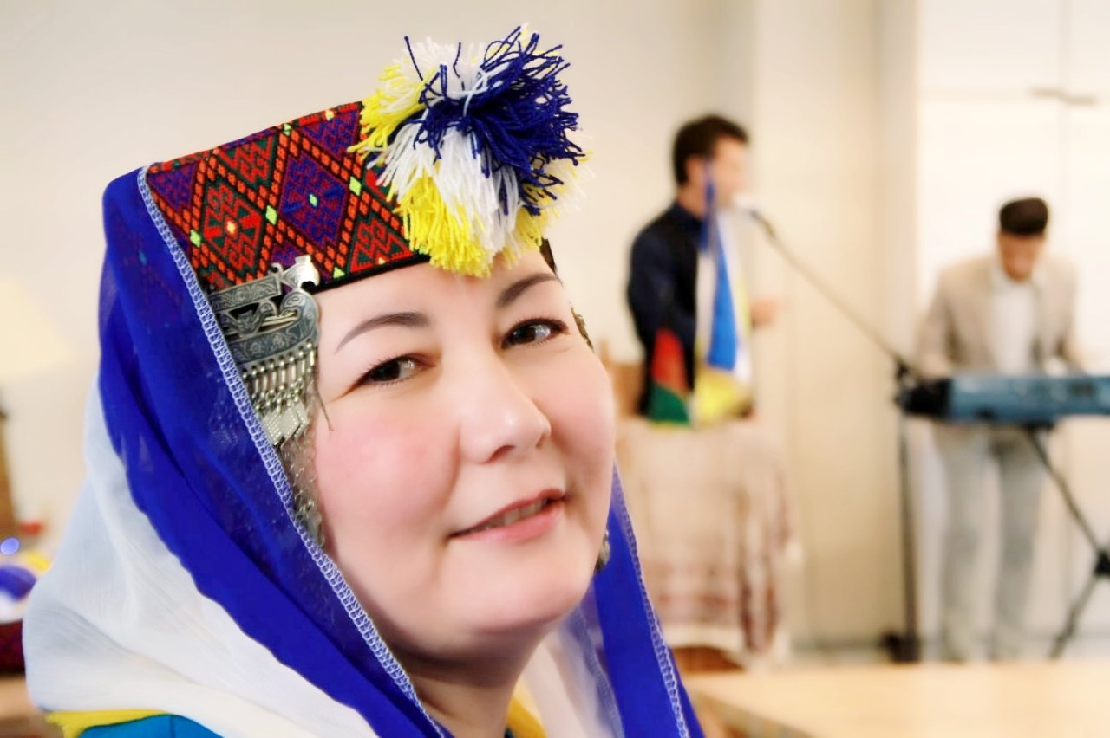
Hazara Face
Hazara costume and the flag of Hazaristan, another dimension of the color combination in Hazara national flag

Slide 26
Hazara Face
Dambora Festival in Bamyan, Hazaristan

Slide 27
Hazara Face
Dambora Festival in Bamyan, Hazaristan

Slide 28
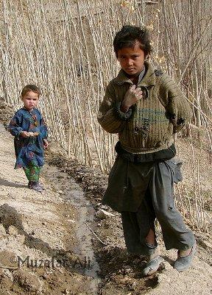
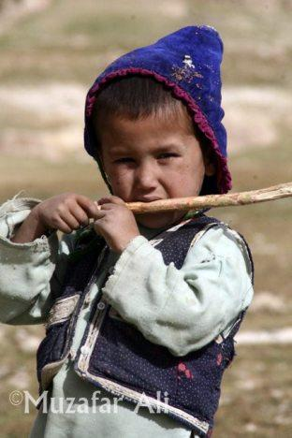
Hazara Face
Boys from the Mirasi Valley, Sangtakht District, Daikundi Province.
A Hazara boy from the Khawat Village, Nawur District of Ghazni Province.

Slide 29
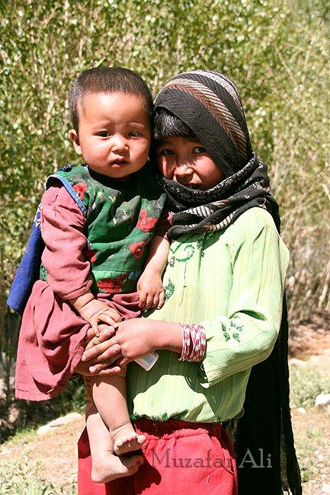
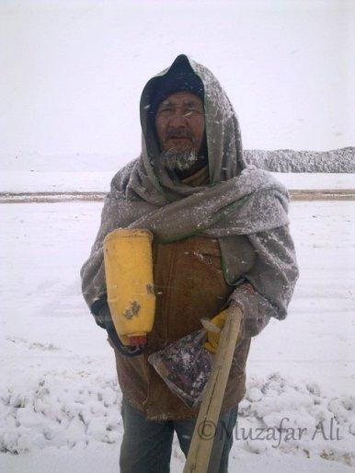
Hazara Face
An old man with a gallon of water and bag of bread at work on the Nili Airstrip, Daikundi. The work continues despite the extreme weather.
A girl with her brother in Pul Band Shoy Village, Behsood 2 District, Maidan Province.

Slide 30
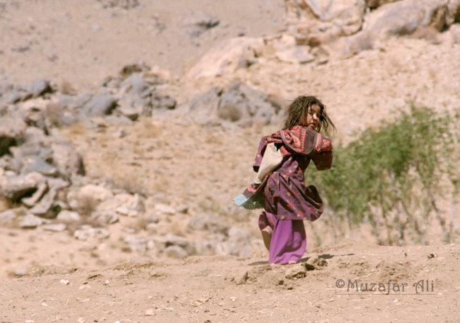
Hazara Face
This young girl was too frightened to be photographed. She thought I might shoot her, and ran towards her house. (Shot in Nili, Daikundi)

Slide 31
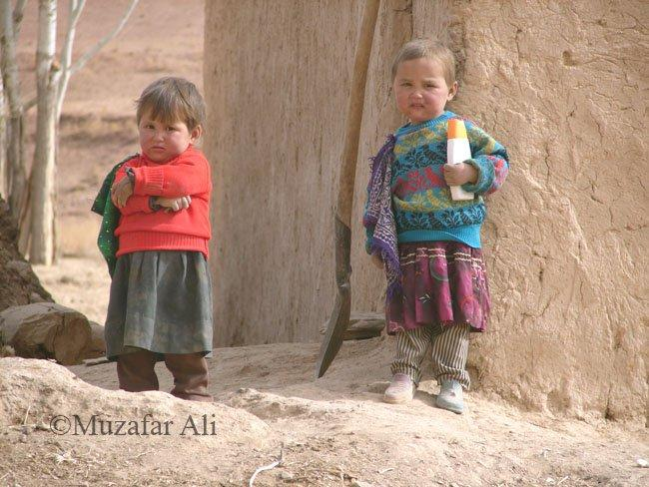
Hazara Face
Children near Siah Chob Village, Sangtakht District, Daikundi. Look at the shoes of the girl on the right. Notice the different colours, and both shoes are for the LEFT foot!

Slide 32
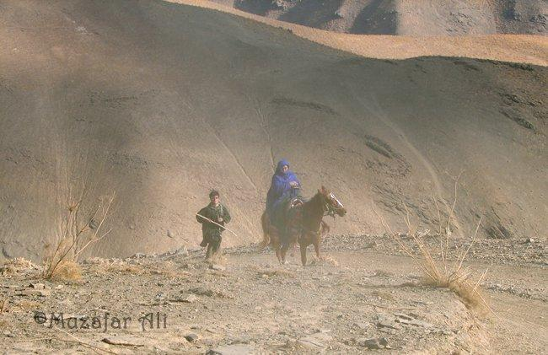
Hazara Face
A woman on horseback crosses Shah Tigh Pass, Khedir District Daikudi.

Slide 33
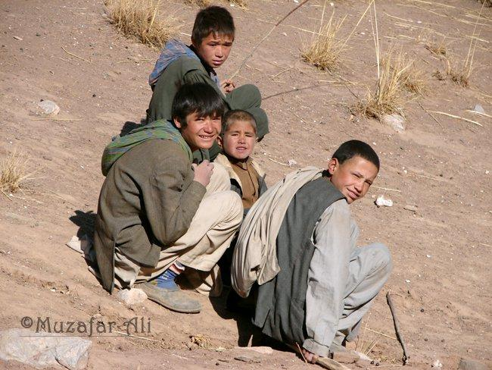
Hazara Face
Some nervous faces from the Pusht Ruq Village, Khedir District, Daikundi Province. Though many parts of Daikundi Province have been affected by war, the Khedir District was one of the worst affected areas.

Slide 34
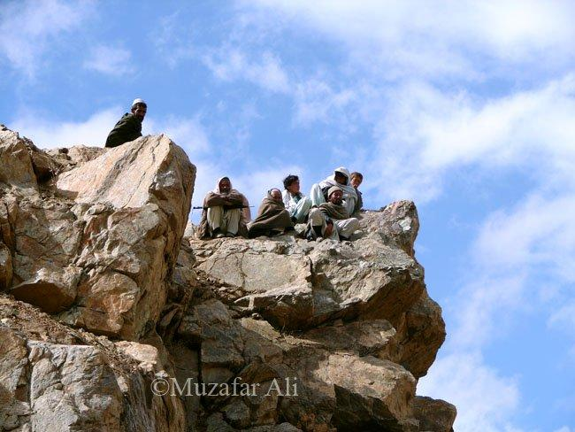
Hazara Face
Men in Nili, Daikundi gazing at the raging Lazir River (2005)

Slide 35
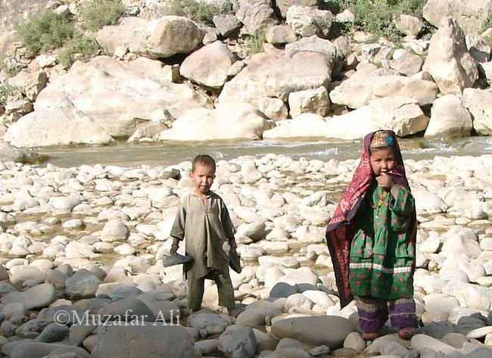
Hazara Face
Two young Hazara children play on a rocky bank of the Lazir River.

Slide 36
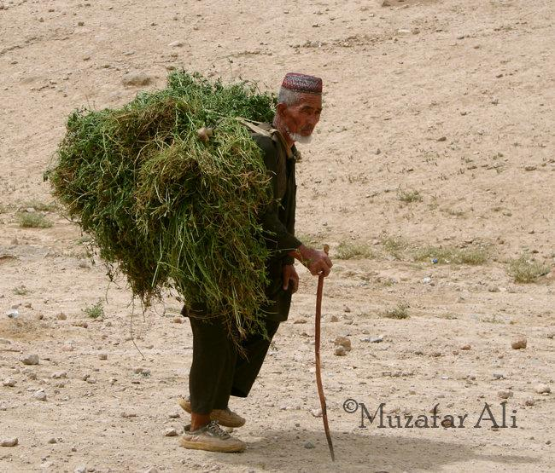
Hazara Face
He needs a stick to support his back, but still must work to survive. From Ashtarlai District, Daikundi.

Slide 37
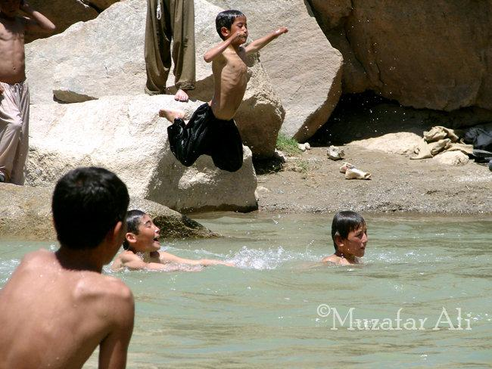
Hazara Face
Boys enjoy swimming in the Lazir River, Nili, Daikundi

Slide 38
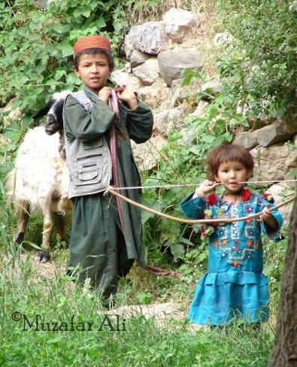
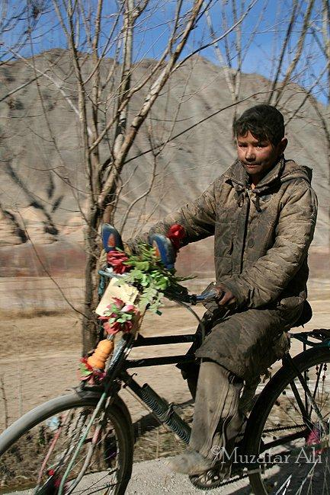
Hazara Face
The bow is still a popular toy with children from the Upper Kissow Valley. Instead of arrows they shoot pebbles. The Upper Kissow Valley is like heaven, and accordingly the people are loving and open.
A young coal miner from the Du Aab Mekh Zarin Village, Kahmard District, Bamyan Province.

Slide 39
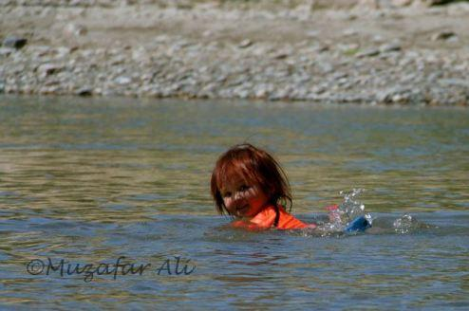
Hazara Face
A cute girl, Fatima from Shah Neko Village, Nili Center, Daikundi Province swims in the Lazir River.

Slide 40
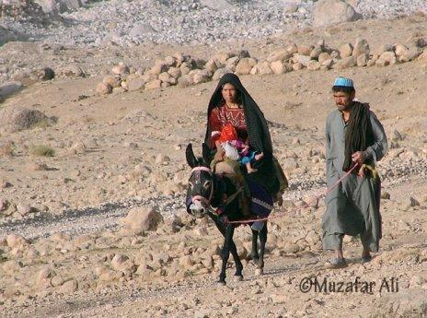
Hazara Face
A Hazara family heads to a clinic in the Kissow Valley, Kitti District, Daikundi Province.

Slide 41
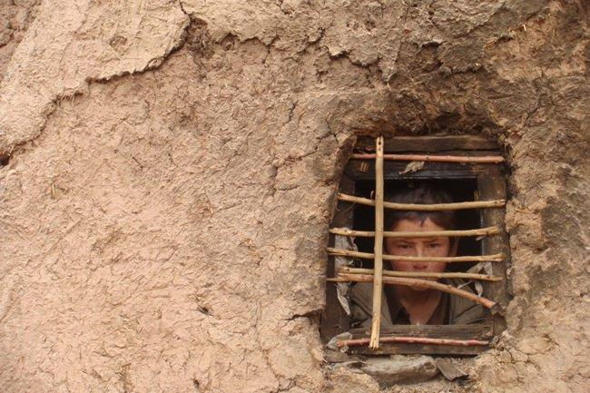
Hazara Face
A boy looks from a window in his house in Bamyan Center, Bamyan.
Photo taken by Hameed Driver, Bamyan.

Slide 42
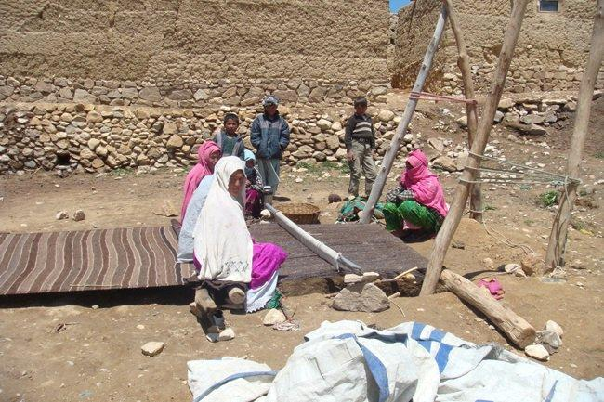
Hazara Face
Women in Hazaristan gather to weave carpet in autumn when they have less work in the fields. During spring and summer, they help men harvest and prepare for winter. Photo by Hameed Driver, Bamyan.

Slide 43
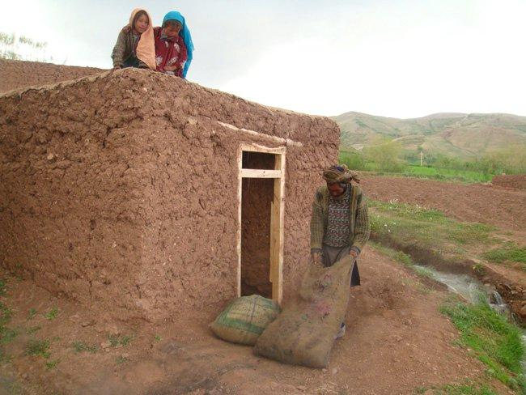
Hazara Face
Preparing for the long and harsh winter season in Bamyan. Photo by Hameed Driver, Bamyan.

Slide 44
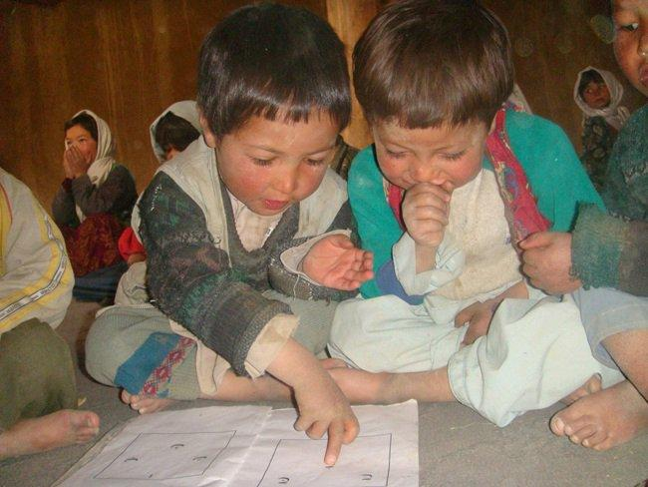
Hazara Face
Excitement beams in the faces of young Hazara students in Bamyan-- both boys and girls. In most of Afghanistan, the government struggles to support education, because of the Taliban's constant threat. Education flourishes in Hazara areas, but the government does little for education in these remote and isolated areas. Instead it focuses on places where people don't value modern education, especially the education of girls. Photo by Hameed Driver, Bamyan

Slide 45
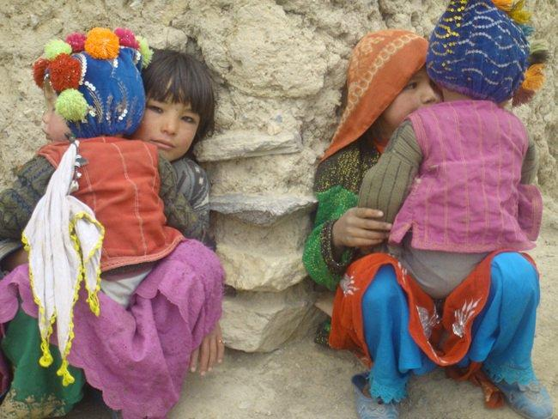
Hazara Face
Girls carry their brothers in Bamyan Center, Bamyan. Photo by Hameed Driver, from Bamyan.

Slide 46
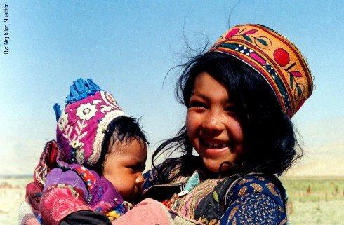
Hazara Face
Chardeh village, Darasouf district, Samangan province.

Slide 47
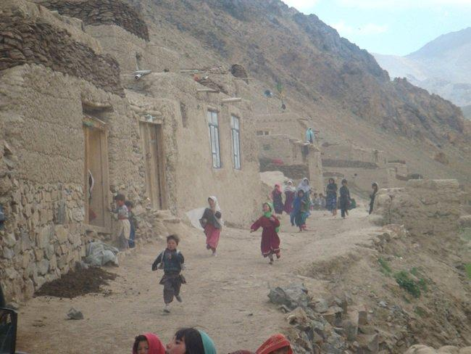
Hazara Face
Colorfully dressed girls and women are a contrast to the stark Bamyan village landscape. Photo by Hameed Driver, Bamyan.

Slide 48
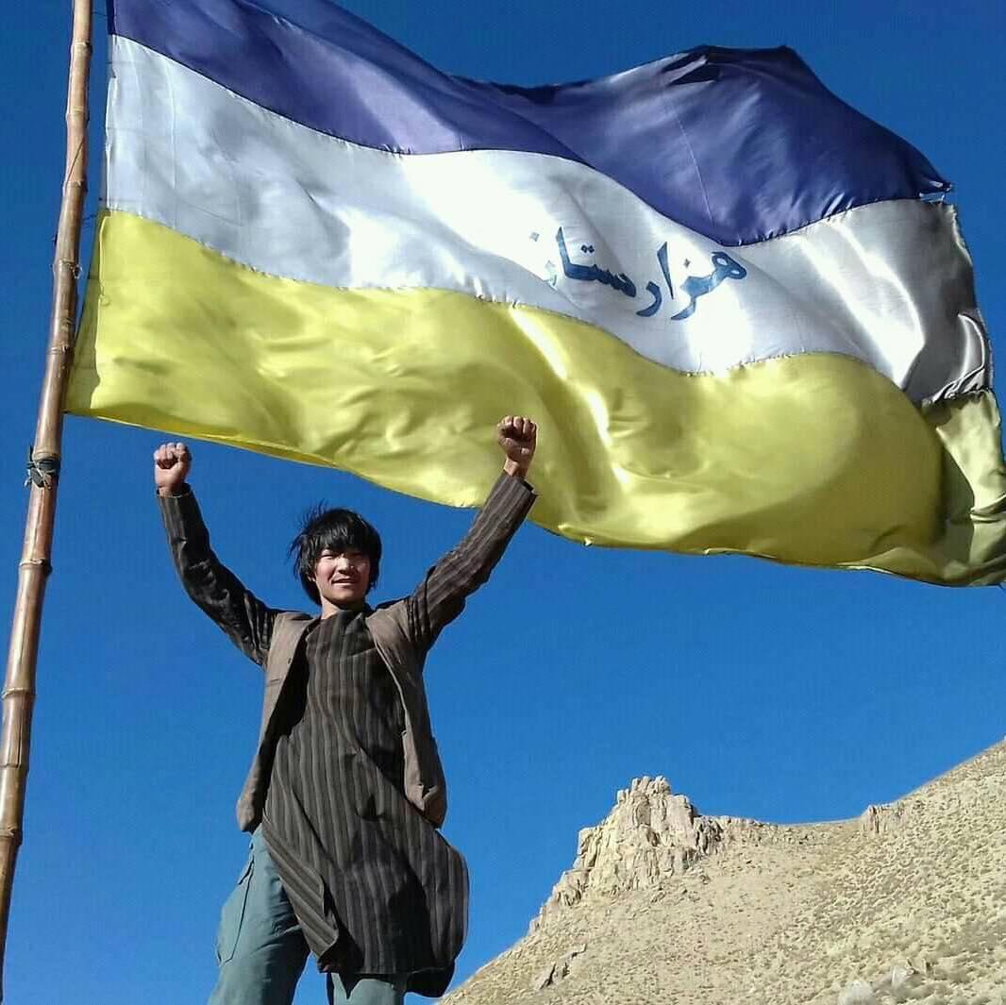
Hazara Face
Up on a mountain of Hazaristan, a Hazara boy with Hazaristan flag

Slide 49
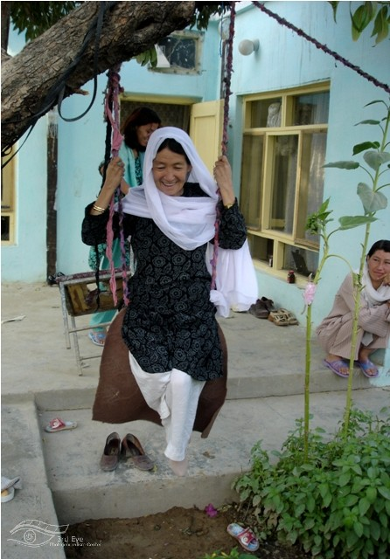
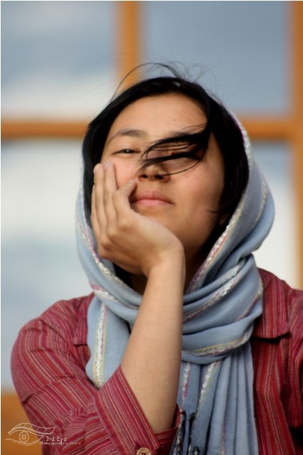
Hazara Face
Photos by By Basir Seerat

Slide 50

Hazara Face
The Hazara insist on educating girls. Photo by By Basir Seerat

Slide 51

Hazara Face
A school in Daikondi. Photo by Muhammad Raja

Slide 52

Persecution of the Hazara people
Convention on the Prevention and Punishment of the Crime of Genocide
Article II
In the present Convention, genocide means any of the following acts committed with intent to destroy, in whole or in part, a national, ethnical, racial or religious group, as such:
(a) Killing members of the group;
(b) Causing serious bodily or mental harm to members of the group;
(c) Deliberately inflicting on the group conditions of life calculated to bring about its physical destruction in whole or in part;
(d) Imposing measures intended to prevent births within the group;
(e) Forcibly transferring children of the group to another group.

Slide 53

Persecution of the Hazara people
Hawke's Bay Herald, Volume XXVIII, Issue 9508, 20 October 1893, Page 2 INDIA.
"CALCUTTA, October 19. It is reported that the Ameer of Afghanistan has sold 10,000 Hazara captives to pay the expenses Incurred in suppressing the revolt."

Slide 54

Persecution of the Hazara people
Thames Star, Volume XXIII, Issue 7241, 20 July 1892, Page 2

Slide 55

Persecution of the Hazara people
Manawatu Herald , 23 July 1892, Page 2

Slide 56

Persecution of the Hazara people
THE AMIR OF AFGHANISTAN CONDEMNING TO DEATH HAZARA PRISONERS OF WAR .
The Graphic (London, England), Saturday, November 4, 1893

Slide 57

Persecution of the Hazara people
Hazara
Land
1
8
9
2
Hawke's Bay Herald, Volume XXVII, Issue 9128, 11 August 1892, Page 3
Pashtun Kuchi attacks from 19th to 21th century

Slide 58

Persecution of the Hazara people
Kuchi-Pashtun attack Hazaras, looting, burning Hazara homes and claiming Hazara land based on Pashtun Ameer's Farman.
2
0
0
7
Pashtun Kuchi attacks from 19th to 21th century

Slide 59

Persecution of the Hazara people
Hazara homes in Behsood looted; Afghan Army stands by chatting with looters
Kabulpress.org was notified today of this video on YouTube. Taped by Mr. Mohammad Ahmadi in the Hazara area of Behshood, Afghanistan, the video shows a pick-up truck piled high with goods looted from the Hazara homes in the background.
Note that the goods include rugs, appliances, and large sacks of grain— all valuable items that can be re-sold. Clothing and other items have been strewn in the dirt. The goal is to discourage Hazara, who fled attacks that have led to many dead and wounded, from returning to their homes.
The Hazara people have lived in Behsood for at least 3,000 years, but their Asian roots and beliefs, stemming more from Buddhism than Islam have made them continual targets of Pashtuns. Hazara culture promotes democracy, equal justice, women's rights and education for all. This has been a great problem with Taliban supporters and fundamentalist Muslims, who are intent on dispersing millions of Hazara, and weakening their influence in modern Afghanistan
Bloody attacks against Hazaras in Afghanistan force thousands to flee Use ctrl + click to open link.
Pashtun Kuchi attacks from 19th to 21th century

Slide 60

Persecution of the Hazara people
Pashtun Kuchi attacks from 19th to 21th century
Back to the primitive past: Pashtuns stoning, trampling with horses, and burning their victims with impunity Use ctrl + click to open link.

Slide 61

Persecution of the Hazara people
Pashtun Kuchi attacks from 19th to 21th century
Use ctrl + click to open link.
Report on the Case of Conflict between Kochies and the local people in Behsood. Afghanistan Independent Human Rights Commission (AIHRC)

Slide 62

Persecution of the Hazara people
Afghanistan’s entire 20th century history has been marked by killings of Hazaras and systematic discrimination against them.
Abdul Khaliq Hazara was a teenage Hazara student who was studying in Kabul. On November 8, 1933 he assassinated Dictator Nadir Khan during a high school visit. He and his entire family and friends were executed publicly. After Dictator Nadir's death, his son, the new king, and his brothers tried to establish relations with the Nazis, based on their common "Aryan race."

Slide 63

Persecution of the Hazara people
Mullah Omar Farman Plans to Destroy the Hazara Cultural and Historical Monument of the Buddahs of Bamiyan
ISLAMIC AMARAT OF AFGHANISTAN MOVEMENT OF TALIBAN
QANDAHAR PROVINCE (SECRET SERVICE CELL).
SECRET ORDER.
1.Ruthless army steps by Taliban against opponent enemy groups.
2.Recovery of arms and collection of Islamic Taxes.
3.Demolition of Mughul,s (Hazaras) historic cultural heritage and remains.
4.Ban for celebrating of Jashn-e-Nouroz (a cultural festival/ new year)
5.Complete economic embargo of Hazarajat.
6.Strict army measures to disown Hazara tribes from their lands and properties forcibly.
7.Disintegration of Hazarajat gradually.
8.Elimination and arrest of communist elements.
9.Rooting out of all mysterious and opponent forces.
10.Anti Shiite propaganda campaign.
11.Assistance for Islamic Madrasas (religious schools) and religious groups.
12.Strict control and watch on women ( to out of their homes).
13.Complete recovery of Taxis from Opium production.
14.Care for transportations and oil.
15.Assistance of Akhund Zadas (Taliban) and religious Mullas.
16.Assistance and care for pro-Taliban Shiite Mullas and commander.
Attention for Kajiki, Kishki Nakhud, Kalat, Shah Joi, Maruf, Hlmand (Name of Provinces and Districts).
May be informed very quick.
Translation of the Pashto text (courtesy: Ishaq Mohammadi)

Slide 64


Persecution of the Hazara people
10–11 February
1993
Afshar, Kabul after the Massacre of Hazaras
More than five thousand Hazaras were killed by the Mujahideen government and its allies. Hazara homes were looted then destroyed in a hail of rockets.

Slide 65


Persecution of the Hazara people
Massacre of Hazaras in Afshar, Kabul

Slide 66

Persecution of the Hazara people
This report documents two massacres committed by Taliban forces in the central highlands of Afghanistan, in January 2001and May 2000. In both cases the victims were primarily Hazaras, a Shia Muslim ethnic group that has been the target of previous massacres and other serious human rights violations by Taliban forces. These massacres took place in the context of the six-year war between the Taliban and parties now grouped in the United National Islamic Front for the Salvation of Afghanistan (the 'United Front'), in which international human rights and humanitarian law have been repeatedly violated by the warring factions. Ethnic and religious minorities, and the Hazaras in particular, have been especially vulnerable in areas of conflict, and Taliban forces have committed large-scale abuses against Hazara civilians with impunity. In this report Human Rights Watch calls upon the United Nations to investigate both massacres and to systematically monitor human rights and humanitarian law violations by all parties to Afghanistan's civil war.
Human Rights Watch, Afghanistan: Massacres of Hazaras in Afghanistan , 1 February 2001, C1301, available at: http://www.unhcr.org/refworld/docid/3ae6a87c4.html [accessed 2 February 2013] Use ctrl + click to open link.
Afghanistan: Massacres of Hazaras in Afghanistan
Human Rights Watch

Slide 67


Persecution of the Hazara people
Ancient Buddha sculptures of Bamiyan, principal symbols of Hazara history and culture!
Destroying Hazara history and making and promoting an inaccurate, demeaning history of their culture have been further strategies, in addition to violent attacks. In March 2001, the Taliban notoriously destroyed the ancient Buddah sculptures of Bamiyan which were principal symbols of Hazara history and culture, and one of the most popular masterpieces of the oral and intangible heritage of humanity. Such is the history of two centuries of crimes against the Hazara, and from which they still suffer.

Slide 68

Persecution of the Hazara people
2007
Daikundi Province, where half-a-million people are dependent on agriculture, the Afghan Department of Agriculture in 2007 had a budget of only $2,400 to improve farming in the area.
Use ctrl + click to open link.
2007
Government's plan to build a modern prison in Daikundi;
Cost $795,566. Use ctrl + click to open link.
Less than 2% of National budget for Hazara- populated areas like Bamyan and Daikundi.

Slide 69

Persecution of the Hazara people
2
0
1
2
Hazara roads are blocked by Taliban gunmen. Hazara cars are halted and its passengers are killed.
A statement of Afghanistan Independent Human Rights Commission (AIHRC) in Dari Use ctrl + click to open link.

Slide 70


Persecution of the Hazara people
2
0
1
4
Hazara passengers executed by Pashtun Taliban in Ghor.

Slide 71

Persecution of the Hazara people
2
0
1
6
Several Hazara passengers abducted, tortured and beheaded by Pashtun Taliban in Zabul.

Slide 72
Persecution of the Hazara people
2
0
1
6
Hazara Protest in Kabul: The Hazara carry the body of Hazara victims abducted, tortured, and beheaded by Pashtun Taliban.

Slide 73


Persecution of the Hazara people
2
0
1
6
The Pashtunist government of Afghanistan blocked roads on the peaceful protest of the Hazara Enlightenment Movement, and isolated protesters in west of Kabul. A bloody attacked carried out by Pashtun suicide bombers killed and injured over 400 including many well-educated activists.

Slide 74


Persecution of the Hazara people
2
0
1
7
Hazara Genocide by Pashtun Taliban and IS, Mass Graves found in Mirza Olang, Sare Pol

Slide 75


Persecution of the Hazara people
2
0
1
7
Bloody Attack on Hazara religious gathering killed over 20, Afghan police arrived 2 hours later!

Slide 76


Persecution of the Hazara people
2
0
1
8
Registration center for upcoming parliamentary election in west of Kabul targeted by Pashtun suicide bombers, over 60 Hazara were killed and at least 122 injured.

Slide 77
Persecution of the Hazara people
2
0
1
8
Registration center for upcoming parliamentary election in west of Kabul targeted by Pashtun suicide bombers, over 60 Hazara were killed and at least 122 injured.

Slide 78


Persecution of the Hazara people
2
0
1
9
Hazara School
The official exam results for admission to military university of so-call country Afghanistan reveal systematic racial discrimination against the Hazara. While the Hazara students with top exam results cannot gain admission, the Pashtuns gain admission with the worst exam results. For instance, in Oruzgan, a Pashtun student with exam result 132 gains admission, but in the same province a Hazara with exam result 312 cannot.

Slide 79

Persecution of the Hazara people
2
0
1
9
Attack on Hazara Writers, Journalists, Artists and Activists
Pashtun Taliban abducted and executed human rights defender Abdul Samad Amiri in Jalriz, while he was traveling from Kabul to Ghor, Hazaristan.
Read more

Slide 80


Persecution of the Hazara people
2
0
2
0
Five Hazara Burned Alive by Pashtun Taliban
Monday 18 May 2020: A few hours after several twits of Taliban lobbier Zalmai Khalilzad in defense of the Taliban, this terrorist group captured, tortured, and burned alive five young Hazaras in Qyāq Valley of Ghazni, Hazaristan.
Taliban acts as the military arm of Pashtunism.

Slide 81


Persecution of the Hazara people
2
0
2
0
Attack on a hospital in Kabul, does not have any other explanation than a war crime, and genocide against the Hazara. The attackers targeted a hospital in the west of Kabul that is mainly populated by the Hazara indigenous people, resulting in killing and injuring dozens, including the newborn Hazara babies and their mothers.

Slide 82

Persecution of the Hazara people
2
0
2
1
Pashtun Taliban loot and burn Hazara Home and display them by force. They settle Pashtuns on Hazara lands.

Slide 83



Persecution of the Hazara people
2
0
2
2
Pashtun suicide bombers freely attack Hazara students at schools and other education centers

Slide 84

Persecution of the Hazara people
Read more

Slide 85

Persecution of the Hazara people
Hazara Genocide in so-called country Afghanistan

Slide 86

Persecution of the Hazara people
Genocide in Pakistan
Click here to see the map.
Pakistan: Abuses, Impunity Erode Rights
ATTACKS ON RELIGIOUS MINORITIES SURGE, JUDICIARY TAKES POLITICAL DECISIONS
Human Rights Watch

Slide 87

Hazara World-wide Protest
In the present Convention, genocide means any of the following acts committed with intent to destroy, in whole or in part, a national, ethnical, racial or religious group, such as:
(a) Killing members of the group;
(b) Causing serious bodily or mental harm to members of the group;
(c) Deliberately inflicting on the group conditions of life calculated to bring about its physical destruction in whole or in part;
(d) Imposing measures intended to prevent births within the group;
(e) Forcibly transferring children of the group to another group.
What is the Convention on the Prevention and Punishment of the Crime of Genocide for?
Kabul, Feb 2013
What is the Refugee Convention for?

Slide 88

2
0
2
1

Slide 89

Hazara World-wide Protest

Slide 90

Hazara World-wide Protest

Slide 91

Hazara World-wide Protest

Slide 92

Hazara World-wide Protest

Slide 93

Hazara World-wide Protest

Slide 94

Hazara World-wide Protest

Slide 95

Hazara World-wide Protest

Slide 96

Hazara World-wide Protest

Slide 97

Hazara World-wide Protest

Slide 98
The Hazara and the Poets Worldwide
Poems for the Hazara: A Multilingual Poetry Anthology and Collaborative Poem
https://en.wikipedia.org/wiki/Poems_for_the_Hazara

Slide 99
The Hazara and the Poets Worldwide
An Open Letter from the Poets World-wide to the Hazara, Civil and Human Rights Organizations, Immigration Authorities, and World Leaders
https://www.hazararights.com/spip.php?article35

Slide 100
Hazaristan Charter
The Hazaristan Charter is the intellectual, philosophical, theoretical foundation, and strategic document to establish a free, developed, and powerful Dai State of Hazaristan. The Hazaristan Charter is the ultimate document to regulate the relationships of the Hazara with each other, the Hazara with Hazaristan, and the Hazara with the world until the establishment of the Dai State of Hazaristan and its pillars, including the Dai Parliament, the National Government, and the Supreme Court, and until the approval of the Hazaristan constitution by the Hazaristan people in the comprehensive referendum.
Read full document in Hazaragi, English and Russian:
https://www.hazaristan.asia/

Slide 101
Resources
Hazara People International Network
www.HazaraRights.com
Hazara Women International
www.HazaraWomen.com
Hazara People Rights
www.HazaraRights.com

